Slide 1
Kubernetes deep dive: container orchestration in the cloud
Speaker: Mounish Pedagandham
Event Managers: Saloni Redij, Nikita Patil

Slide 2

What we will cover today
Resources:
https://tinyurl.com/k8resources
Motivation to use Kubernetes
Technology of Kubernetes (Core Kubernetes Concepts)
Various Resources
Core components
Hands on with kubectl and minikube
Understanding YAML Configuration files
Deploy a demo Kubernetes cluster
Kubernetes Namespaces

Slide 3
Motivation

Slide 4
How the deployment changed over years?
2000s: Traditional Deployment Era
2010s: Virtualized Deployment Era
On-premises Deployments: Companies managed their own data centers or used colocation services.
Bare Metal Servers.
Monolithic Architecture.
Homegrown Monitoring Tools.
Big team of System Administrators.
Cloud Computing: Virtual Machines (VMs) are created and destroyed in minutes, providing greater flexibility and scalability.
Configuration Management Tools.
Manual Bin-Packing.
Improved Tooling.
Challenges with Scale.
https://tinyurl.com/k8resources
Notes:
2000s: Traditional Deployment Era
During the 2000s, we experienced what is known as the "Traditional Deployment Era". This period was characterized by:
On-premises Deployments: Companies managed their own data centers or used colocation services.
Teams of Sysadmins: Dedicated teams of system administrators were responsible for provisioning and managing fleets of servers, which was often a labor-intensive and immature process.
Bare Metal Servers: Applications ran directly on physical servers.
Monolithic Architecture: The prevalent architectural style was monolithic, where applications were built as single, indivisible units.
Homegrown Monitoring Tools: Monitoring and managing applications required custom-built tools due to the lack of standardized solutions
2010s: Virtualized Deployment Era
The 2010s marked the transition to the "Virtualized Deployment Era". Key developments during this time included:
Cloud Computing: The advent of cloud computing allowed Virtual Machines (VMs) to be created and destroyed in minutes, providing greater flexibility and scalability.
Configuration Management Tools: Tools like Puppet and Chef became popular for managing infrastructure as code, simplifying the configuration and management of large-scale deployments.
Manual Bin-Packing: Applications were manually allocated to VMs, optimizing resource usage but still requiring significant manual effort.
Improved Tooling: The emergence of better tooling made it practical to manage a larger number of applications and cloud resources.
Challenges with Scale: Despite the improvements, managing large numbers of cloud resources remained a significant challenge.

Slide 5
How the deployment changed over years?
2020s: Container Deployment Era
Workload Orchestrators: Tools like Kubernetes enabled treating clusters of machines as a single resource, simplifying management and scaling.
Standard Interfaces and Utilities: These orchestrators provided a range of utilities and interfaces to handle:
Efficient Scheduling: Optimally distributing workloads across instances.
Health Checks: Monitoring the health and status of applications.
Service Discovery: Automating the detection of service locations within the cluster.
Configuration Management: Standardizing the way configurations are managed and applied.
Autoscaling: Automatically adjusting the number of running instances based on demand.
Persistent Storage: Managing storage that persists beyond the lifecycle of individual containers.
Networking: Ensuring reliable and scalable networking between services.
https://tinyurl.com/k8resources

Slide 6
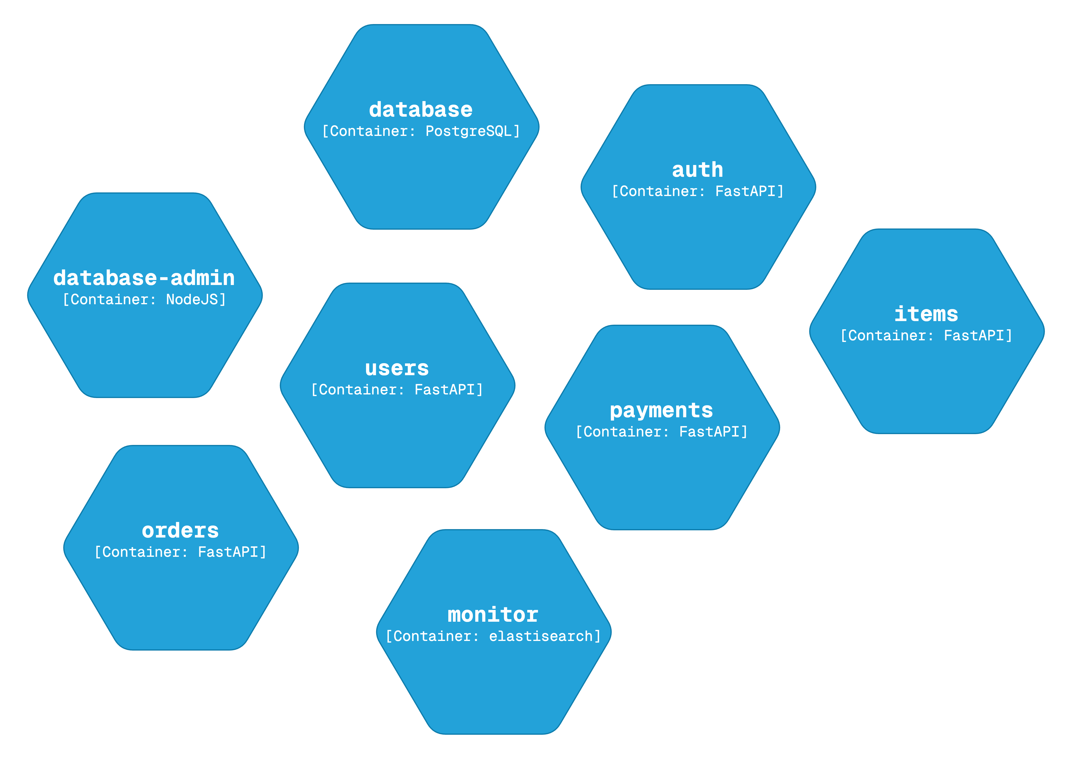
What is Kubernetes?
Why?
Kubernetes, also known as K8s, is an open-source system for automating deployment, scaling, and management of containerized applications.
Essentially it is a container orchestration platform.
Solves critical challenges in modern distributed systems.
Allows you to deploy to any environment – physical, cloud, virtual.
Move from monolith to microservices.
Increase use of containers.
https://tinyurl.com/k8resources

Slide 7
What does Kubernetes offer?
Automated rollouts and rollbacks
Service Discovery and load balancing
Storage Orchestration
Secret and Configuration management
Self Healing
Secret and Configuration Management
Batch Execution
Automatic bin packing
Horizontal Scaling
Ipv4/IPv6 dual-stack
Designed for extensibility
It ensures that the application has:
High Availability
Scalability
Disaster Recovery
Fault Tolerance – we’ve to configure it though
https://tinyurl.com/k8resources
Notes:
Automated rollouts and rollbacks: Kubernetes progressively rolls out changes to your application or its configuration, while monitoring application health to ensure it doesn't kill all your instances at the same time. If something goes wrong, Kubernetes will rollback the change for you
Service discover and load balancing: No need to modify your application to use an unfamiliar service discovery mechanism. Kubernetes gives Pods their own IP addresses and a single DNS name for a set of Pods, and can load-balance across them.
Storage Orchestration: Automatically mount the storage system of your choice, whether from local storage, a public cloud provider, or a network storage system such as iSCSI or NFS.
Self Healing: Restarts containers that fail, replaces and reschedules containers when nodes die, kills containers that don't respond to your user-defined health check, and doesn't advertise them to clients until they are ready to serve.
Secret and Configuration Management: Deploy and update Secrets and application configuration without rebuilding your image and without exposing Secrets in your stack configuration.
Batch Execution: Kubernetes can manage your batch and CI workloads, replacing containers that fail, if desired
Horizontal Scaling: Scale your application up and down with a simple command, with a UI, or automatically based on CPU usage.
Ipv4/IPv6 dual-stack: Allocation of IPv4 and IPv6 addresses to Pods and Service
Designed for extensibility: Add features to your Kubernetes cluster without changing upstream source code.

Slide 8
Technology of Kubernetes

Slide 9
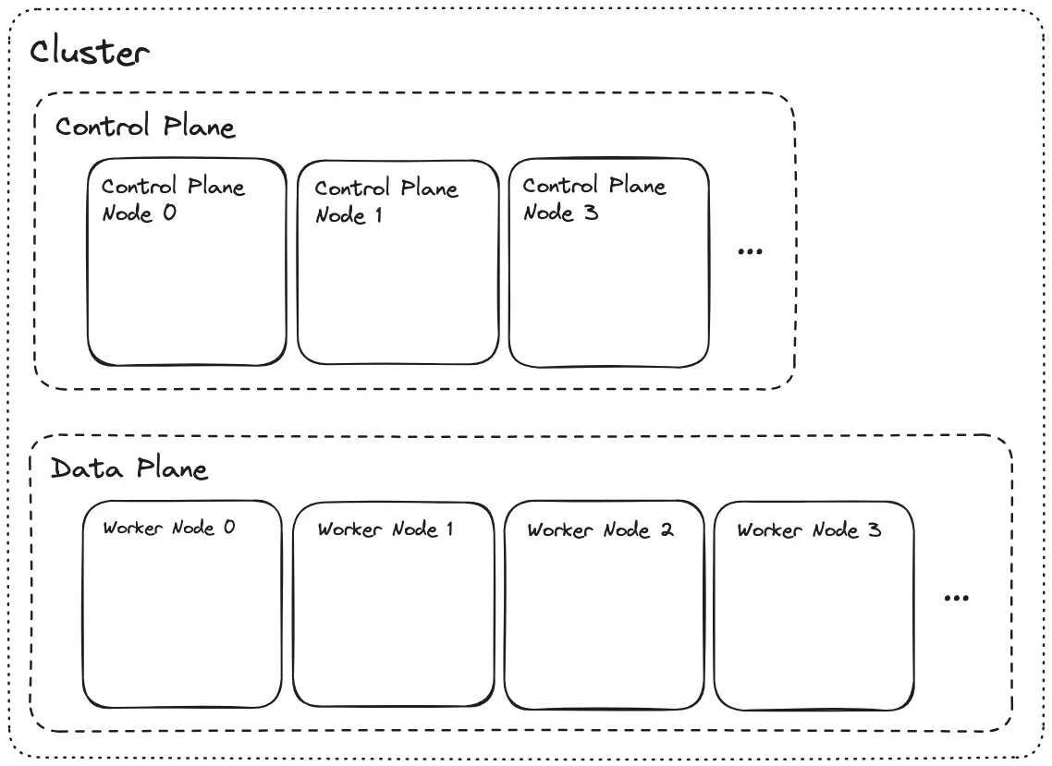
K8s Concepts
Node: A "node" is a computer/server. Multiple nodes are joined together to form a "cluster".
A Kubernetes cluster consists of a control plane and one or more worker nodes.
Control Plane: A subset of nodes in the cluster dedicated to performing system tasks. Referred to as “control plane nodes” (master).
Data Plane: A subset of nodes in the cluster dedicated to running user workloads. Referred to as “worker nodes”.
https://tinyurl.com/k8resources

Slide 10
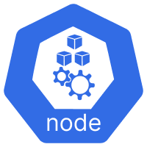
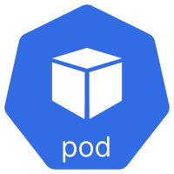
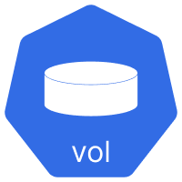
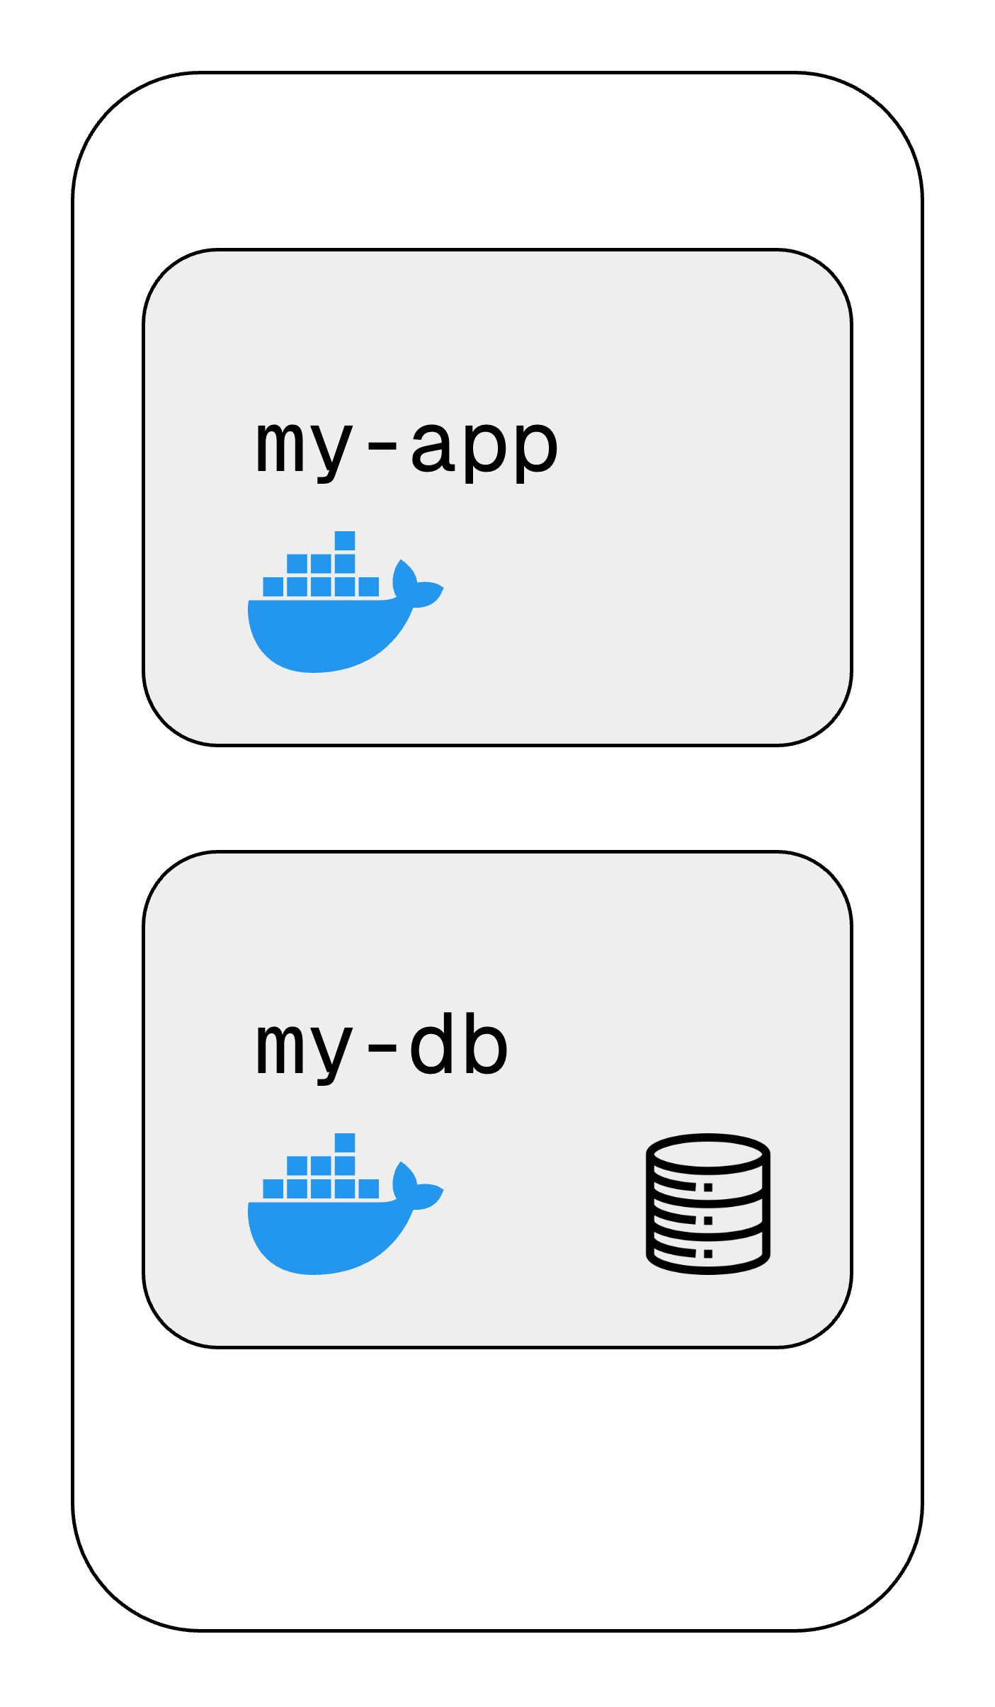
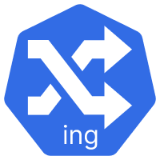
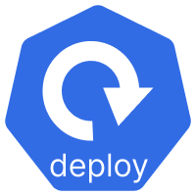
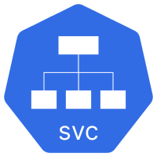
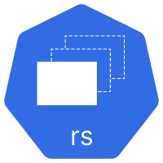

Notes:
Let us understand the most basic components of K8s to get you started using Kubernetes in practice.
Kubernetes has tons of components. But at most of time, we only work with a handful of them.
We will understand by setting up a simple JS application and a database.

Slide 11
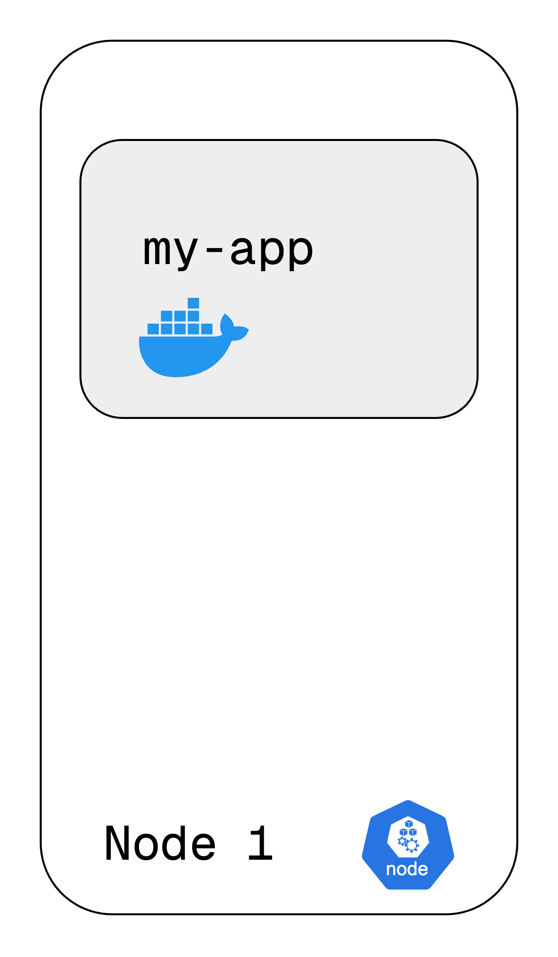
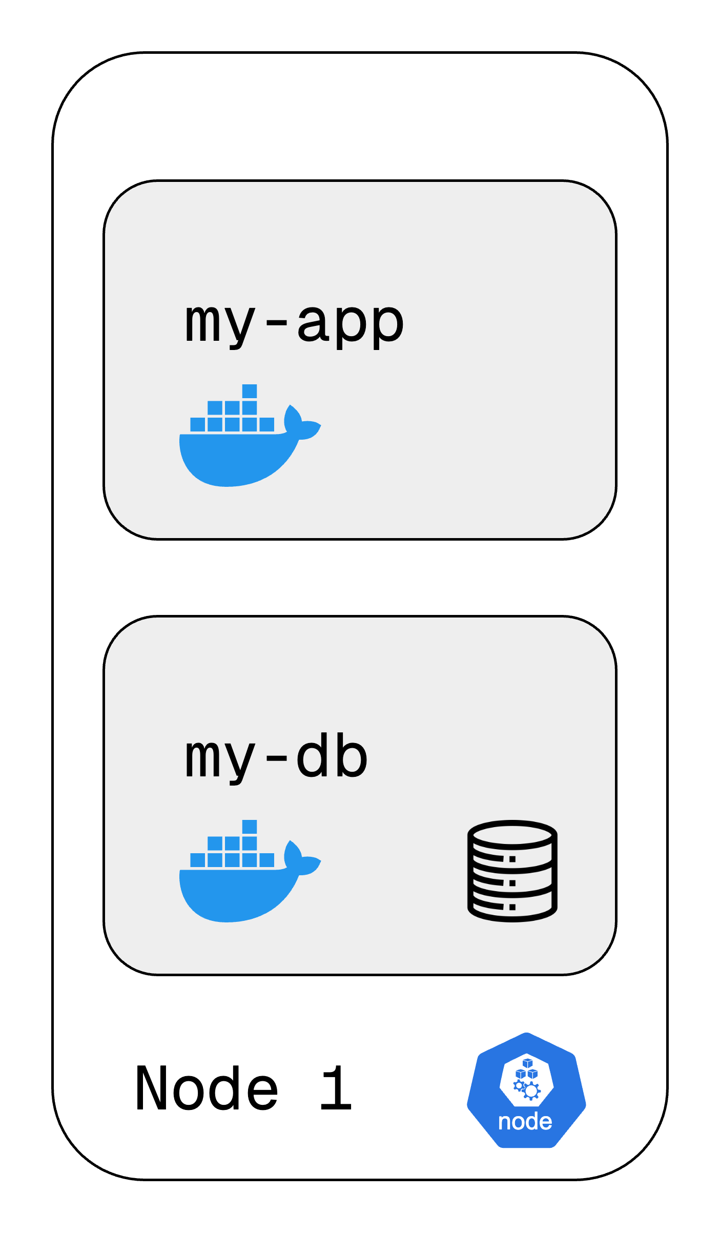
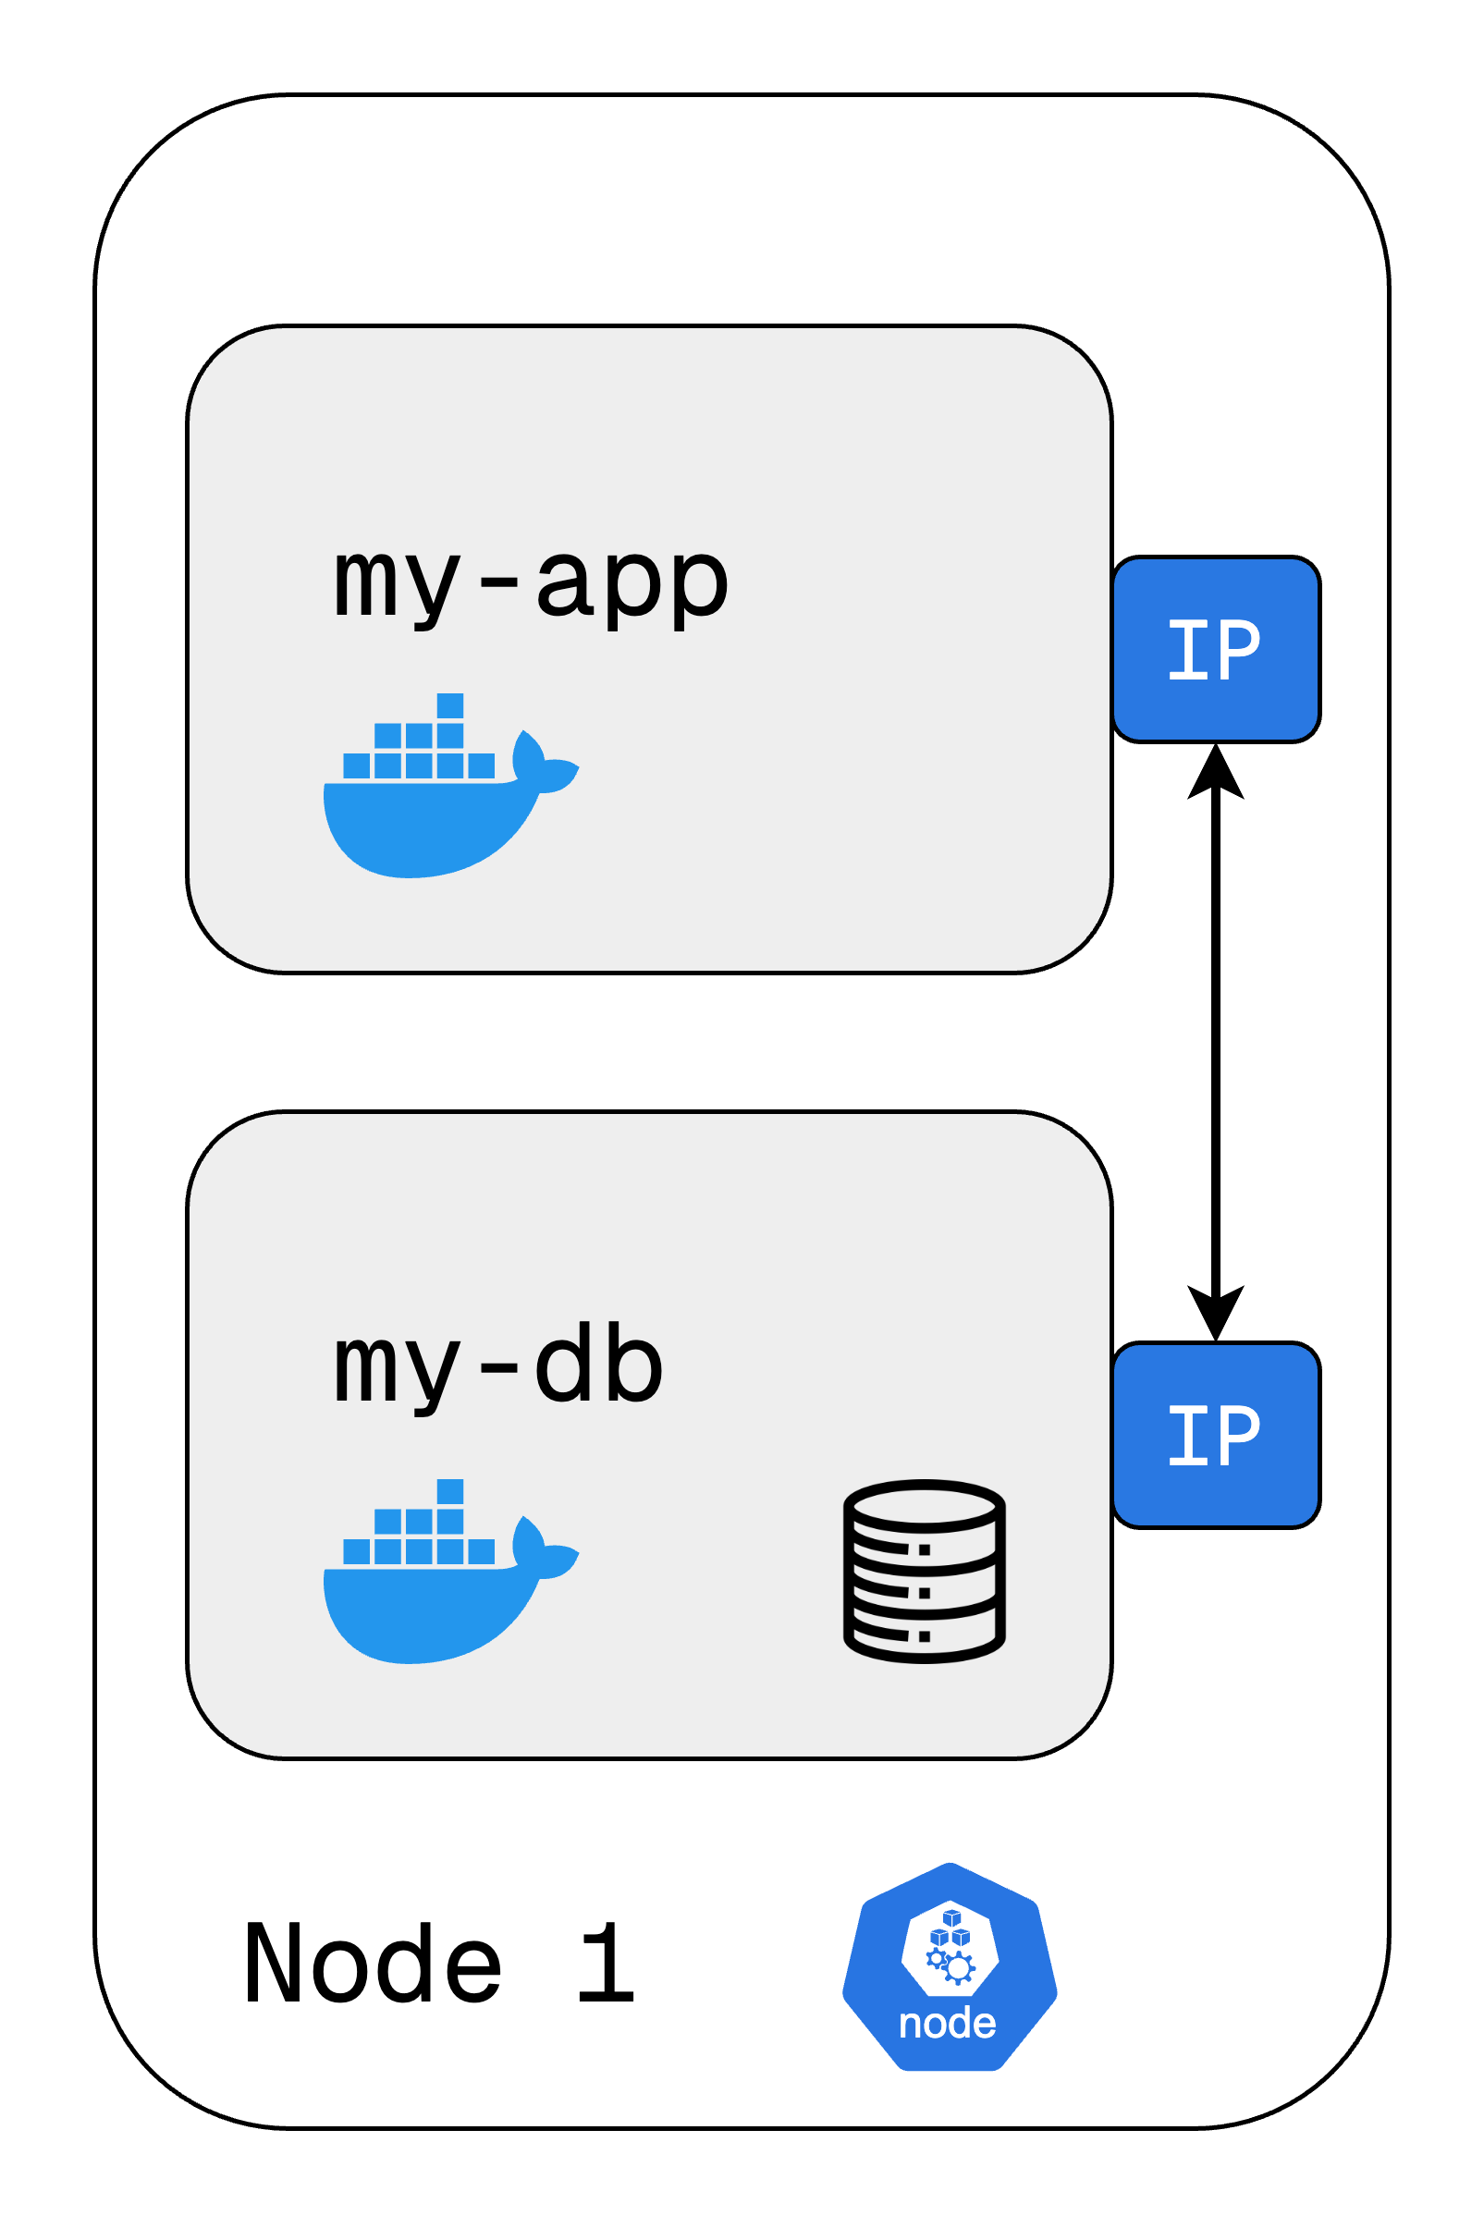
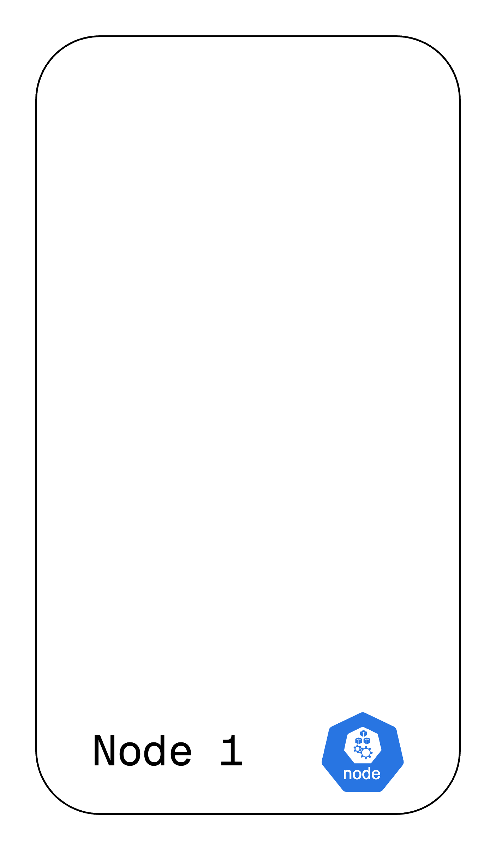
Pod
Smallest and simplest unit in the Kubernetes object model that you can create or deploy.
It is an abstraction over container.
Usually 1 container per pod.
Each pod gets its own IP address.
New IP address on recreation.
Note: In the real world you will and should not create pods directly. Instead, you will work with the higher-level resources like Deployments and Jobs and let Kubernetes manage the underlying pods.
https://tinyurl.com/k8resources
Notes:
Each pod is assigned an IP address to make it reachable via the network, but the pods are considered ephemeral and may be deleted at any time.
To provide a stable way to address a set of pods (e.g. from a Deployment) we use a Service. There are a variety of kinds of services that provide access to pods from within or outside of the cluster.

Slide 12
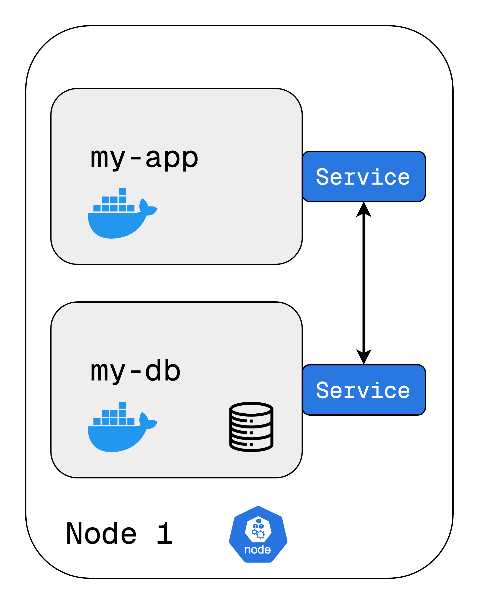
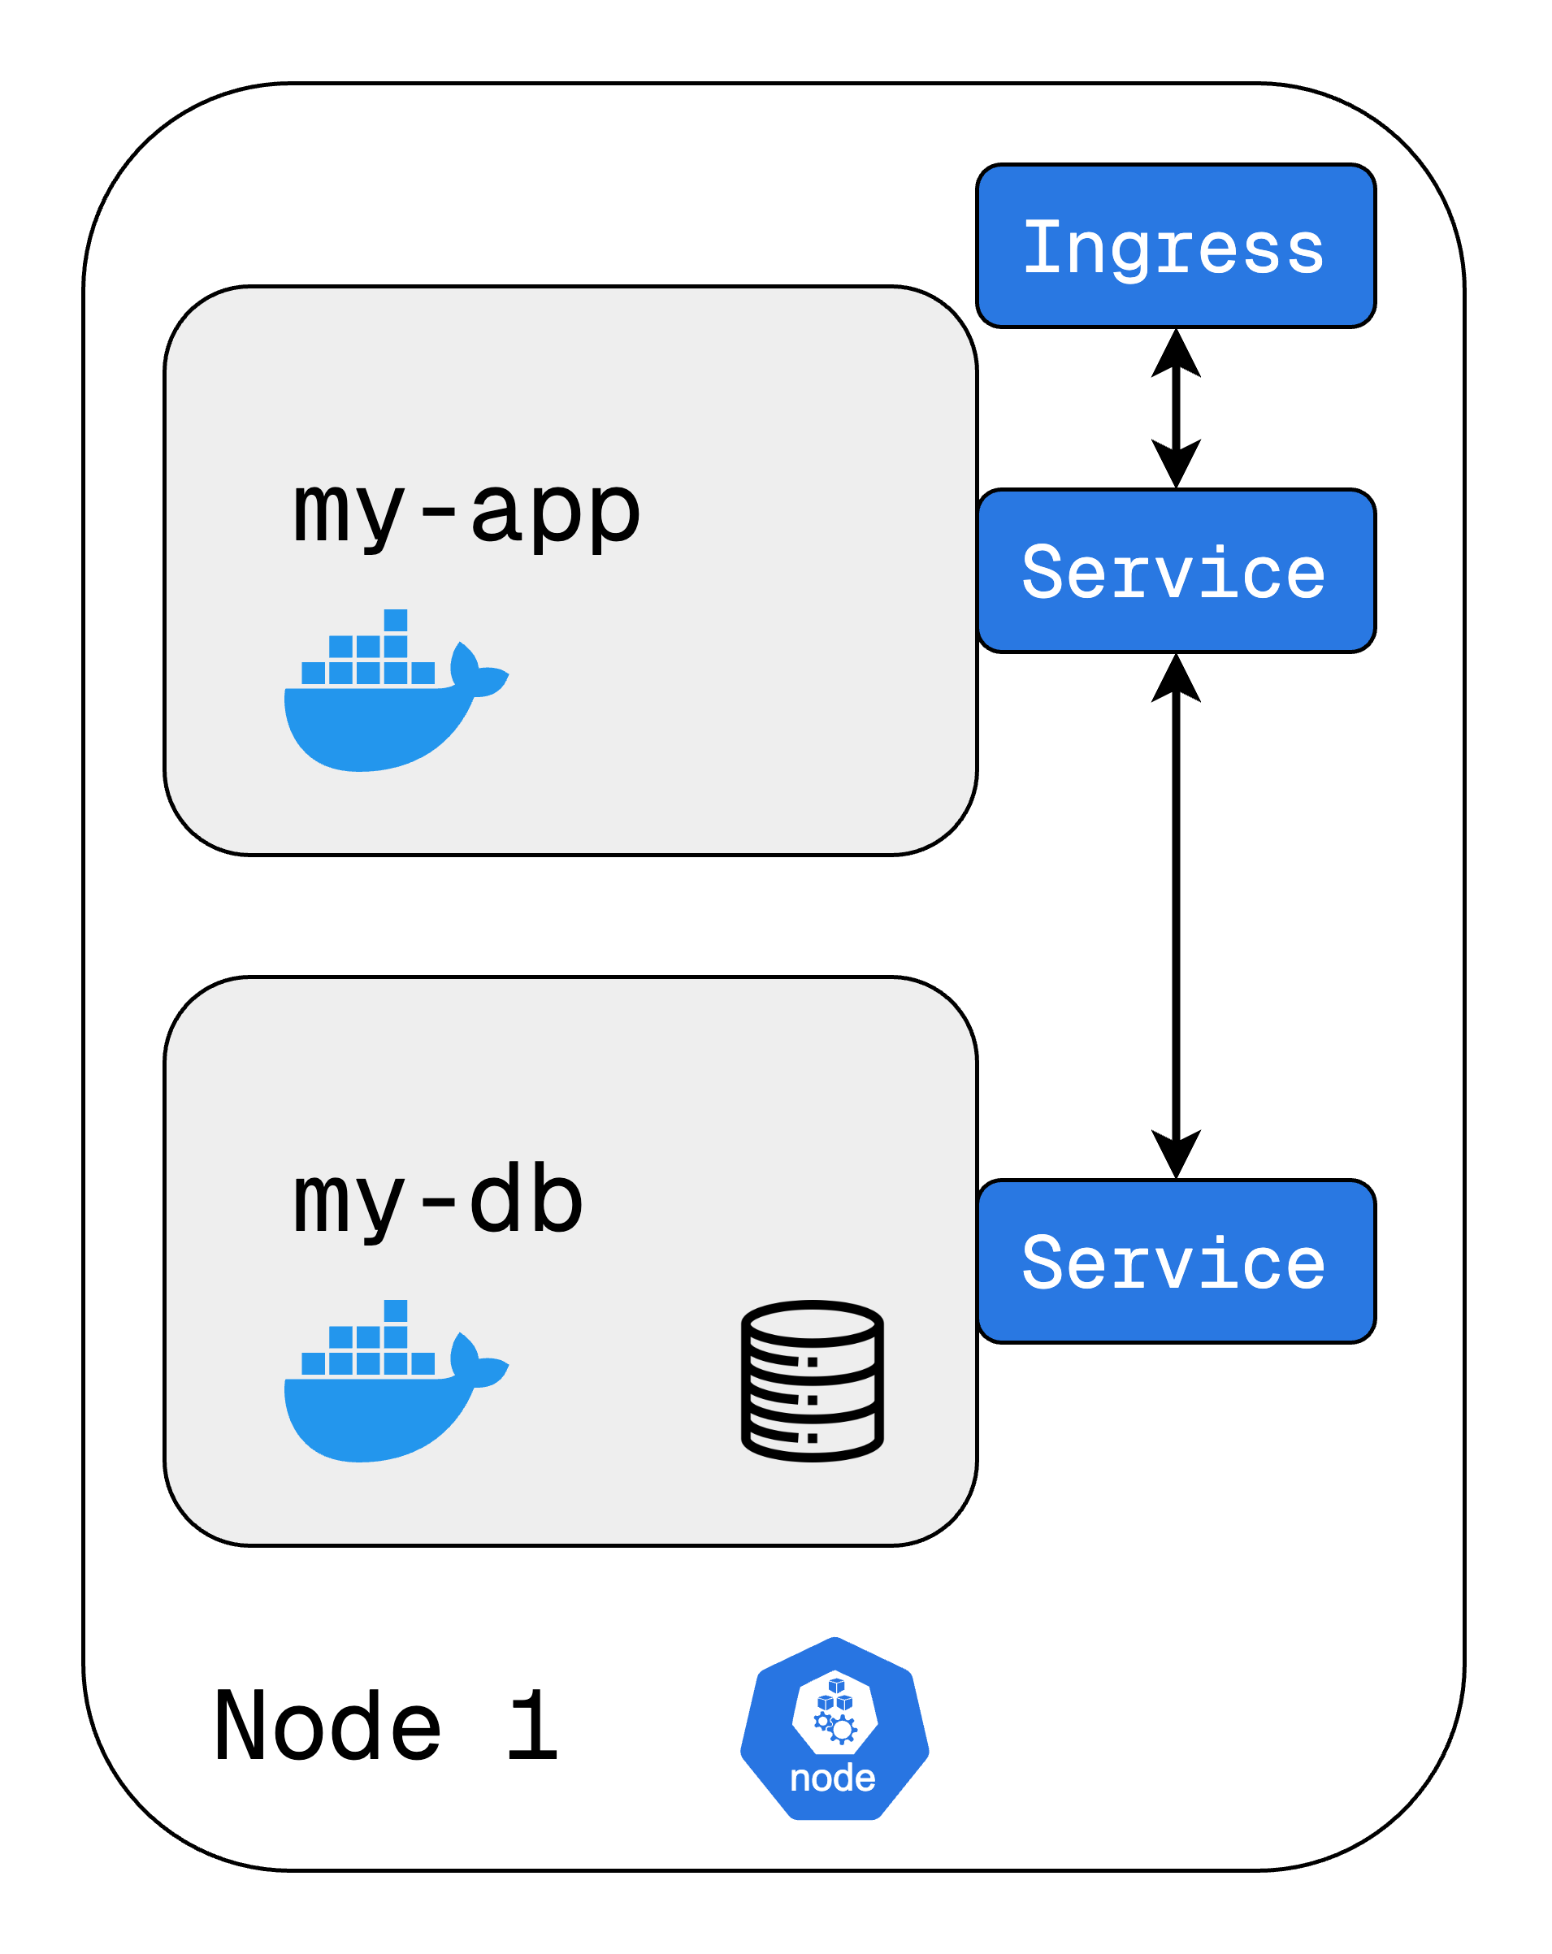
Service (and Ingress)
Service is a method for exposing a network application that is running as one or more Pods in your cluster.
It is an abstraction to help you expose groups of Pods over a network.
Essentially, it provides a permanent IP address to your Pod
Lifecycles of Pod and Service are not connected.
To connect to your app from outside the cluster, we use an external service.
However, in production, we use ingress. The request first comes to ingress and is forwarded to external service of the pod.
https://tinyurl.com/k8resources

Slide 13
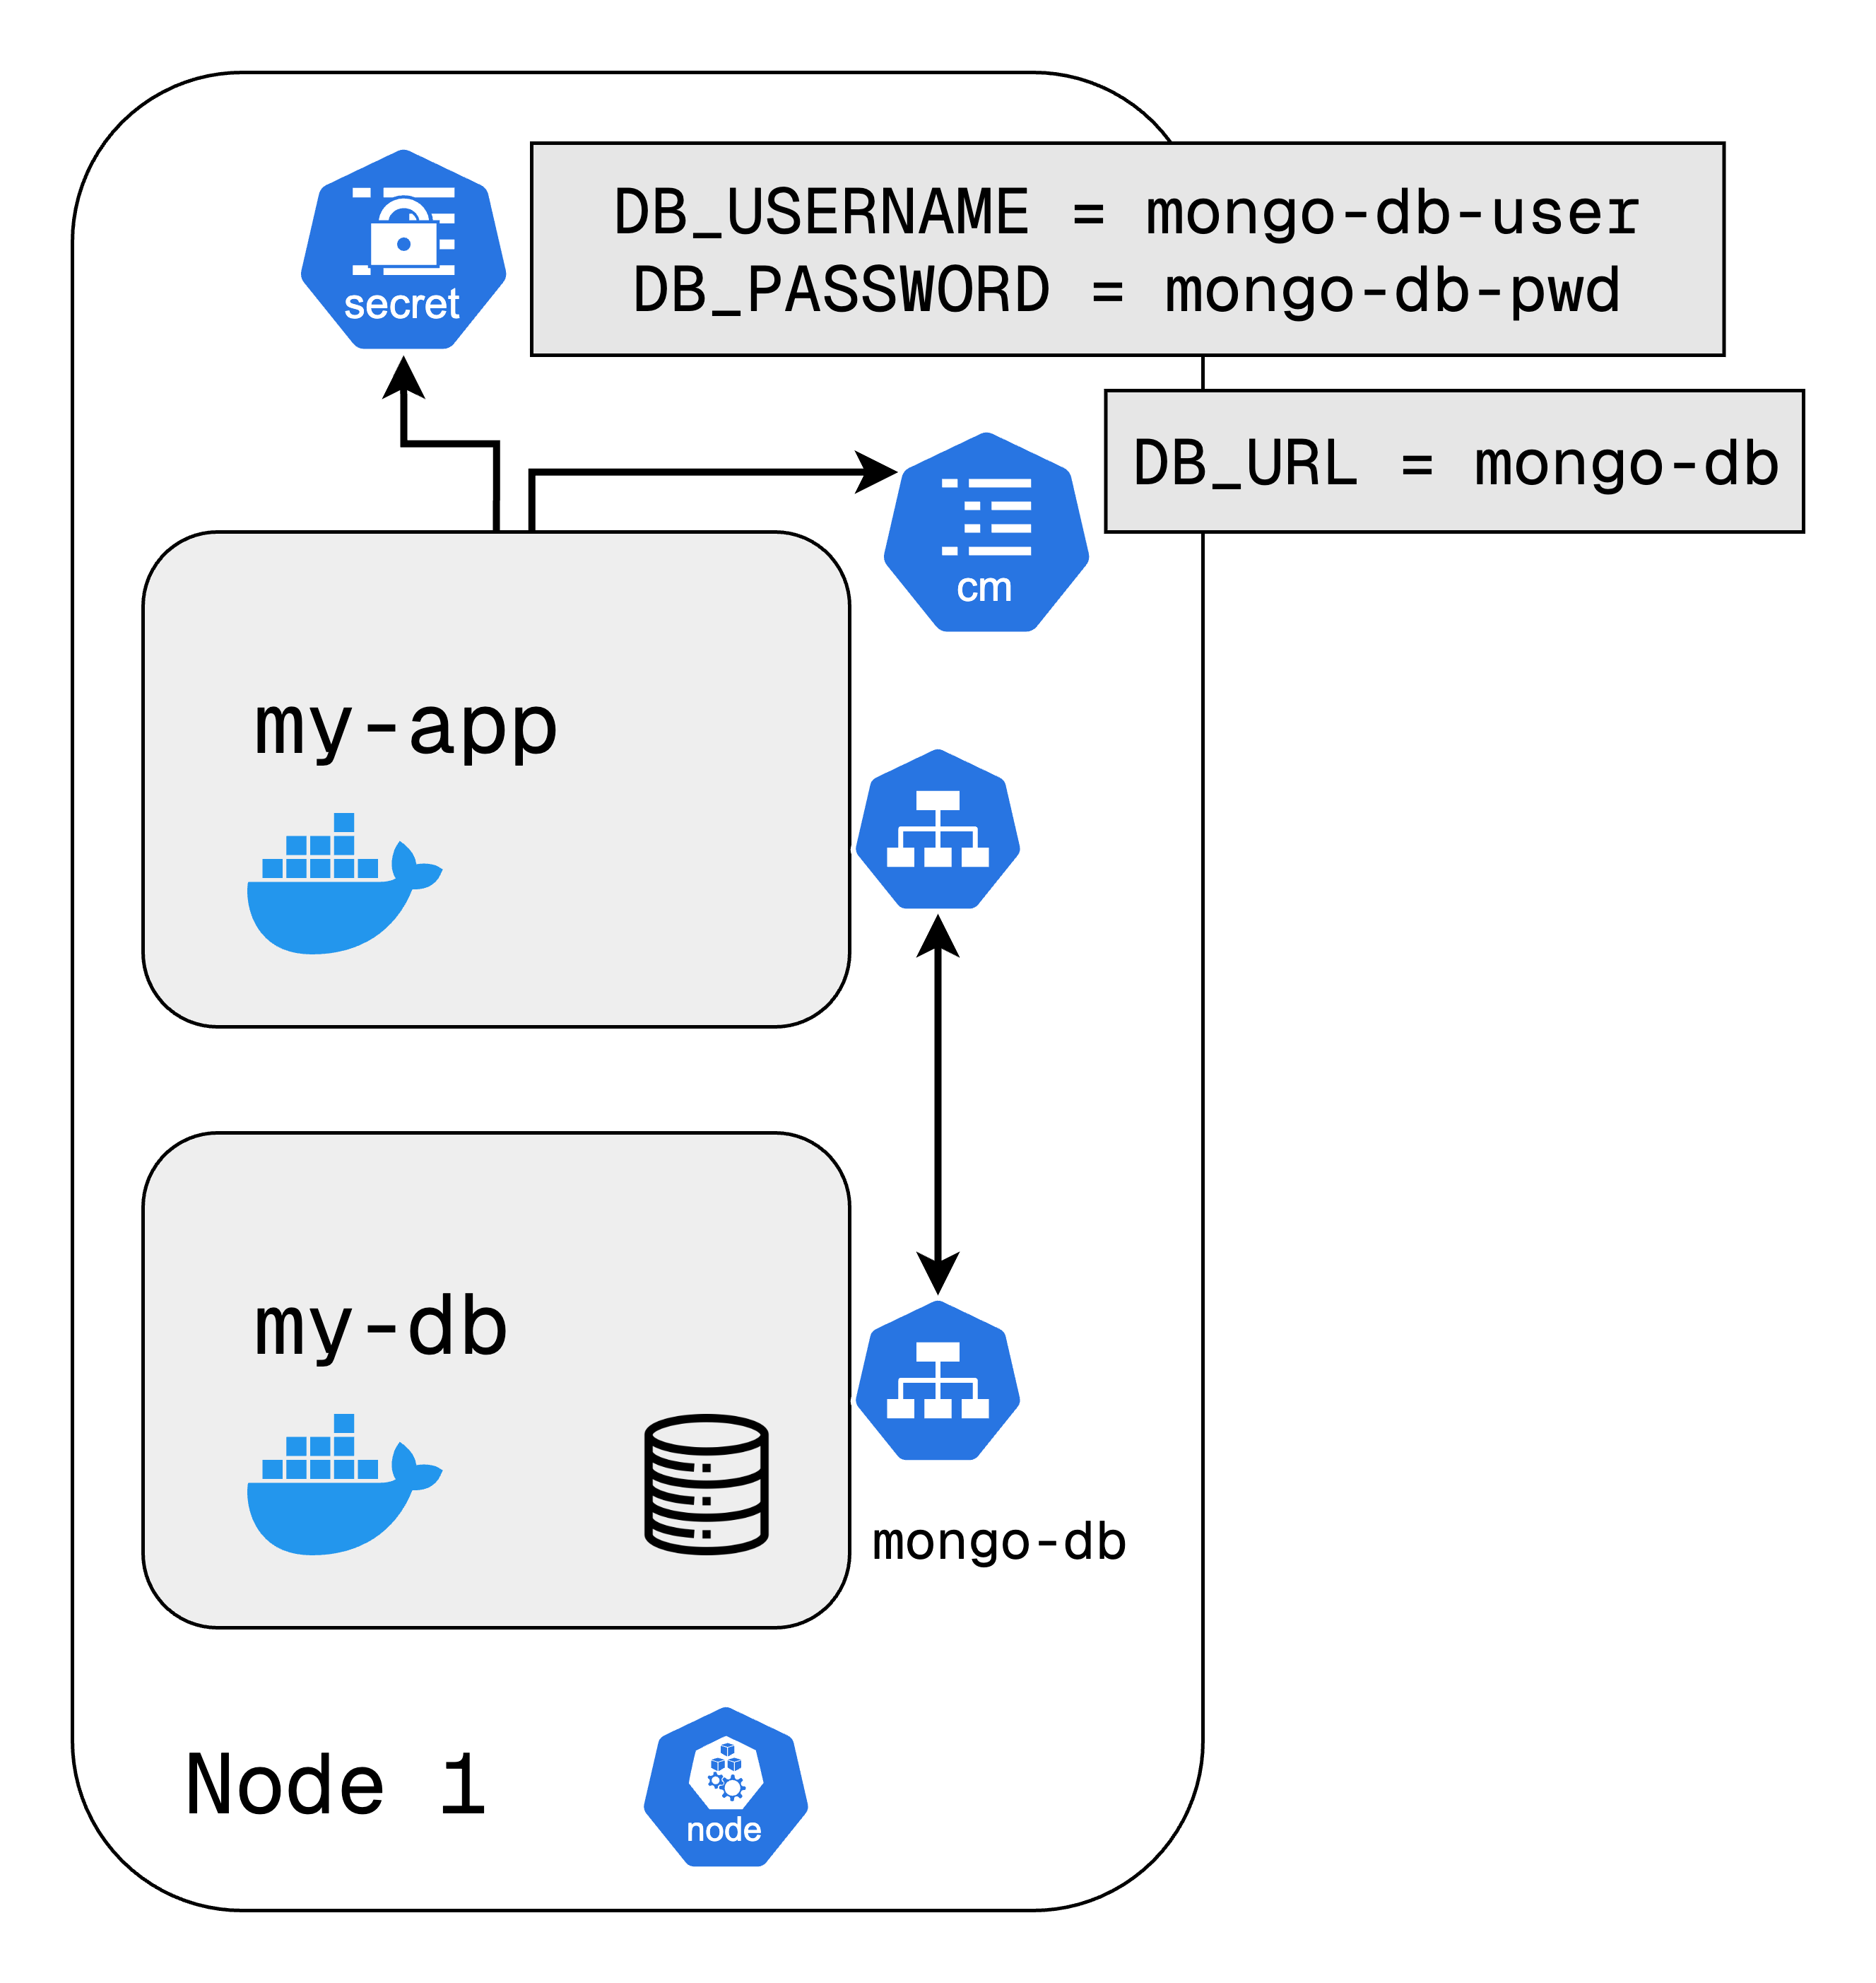
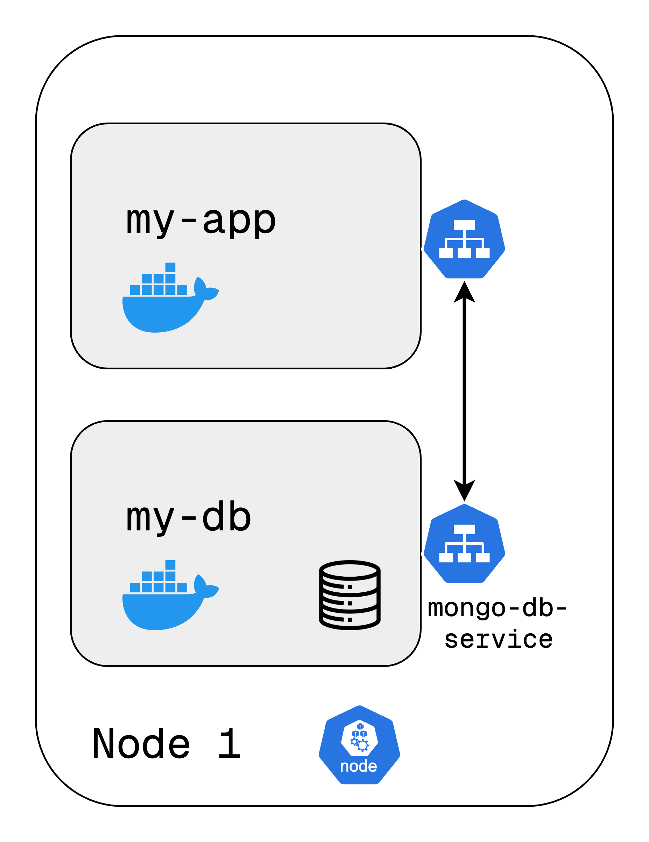
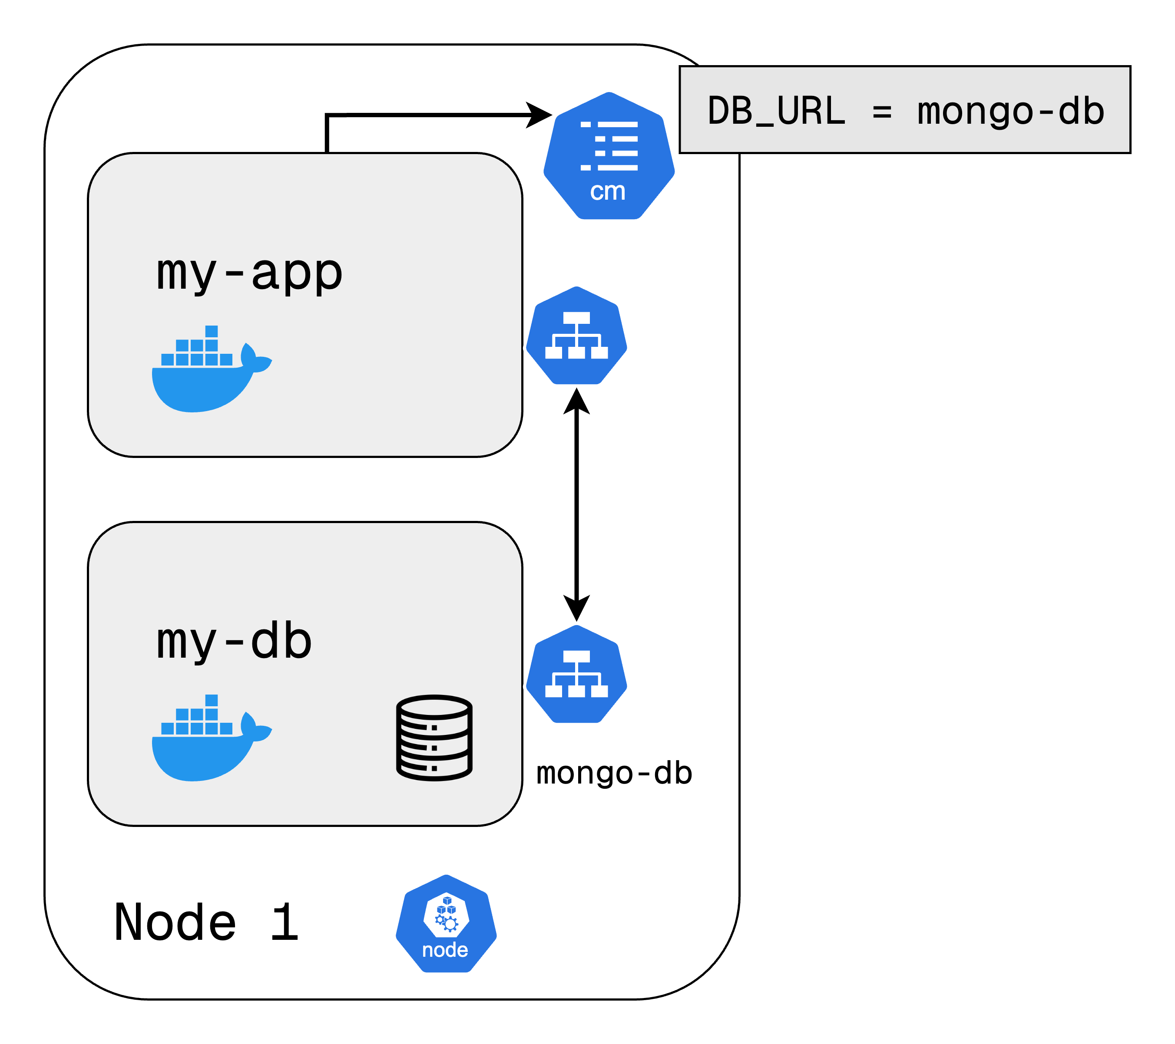
ConfigMap and Secret
ConfigMap is used to store non-confidential data in key-value pairs. It is simply external configuration of your application.
Pods can consume ConfigMaps as environment variables, command-line arguments, or as configuration files in a volume.
Secrets provide a way to manage sensitive information, such as passwords, tokens, or API keys, that require more security than standard configurations.
Data in Secrets is base64 encoded.
Note: The base64 encoding alone doesn’t provide protection. It is just a method to support binary data
Notes:
Pods communicate with each other using a service so express app will have a database endpoint let's say called ‘mongodb-service’ that it uses to communicate with the database. But where do you configure usually this database URL or endpoint? Usually, you would do it in application properties file or as some kind of external environmental variable. It is usually it's inside of the built image of the application.
For example, if the endpoint of the service or service name in this case changed to ‘mongodb’ you would have to adjust that URL in the application so you'd have to rebuild the application with a new version and you must push it to the repository and now you'll have to pull that new image in your pod and restart the whole thing. It is a little bit tedious for a small change like a database URL.
so for that purpose k8 has a component called configmap so what it does is it's basically your external configuration to your application. ConfigMap contains the configuration data like URLs of a database or some other services that you use and in kubernetes you just connect it to the Pod so that pod actually gets the data that configmap contains and now if you change the name of the service or the endpoint of the service you just adjust the config map and that's it you don't have to build a new image and have to go through this whole cycle.
Part of the external configuration can also be database username and password. They may also change in the application deployment process but putting a password or other credentials in a config map in a plain text format would be insecure even though it's an external configuration.
So for this purpose k8 has another component called secret. It is just like config map but the difference is that it is used to store secret data credential. They are not stored in a plain text format, but in base 64 encoded format.
So secret would contain things like credentials, passwords certificates things that you don't want other people to have access.
You can connect the secret as you would connect a configmap to your pod.

Slide 14
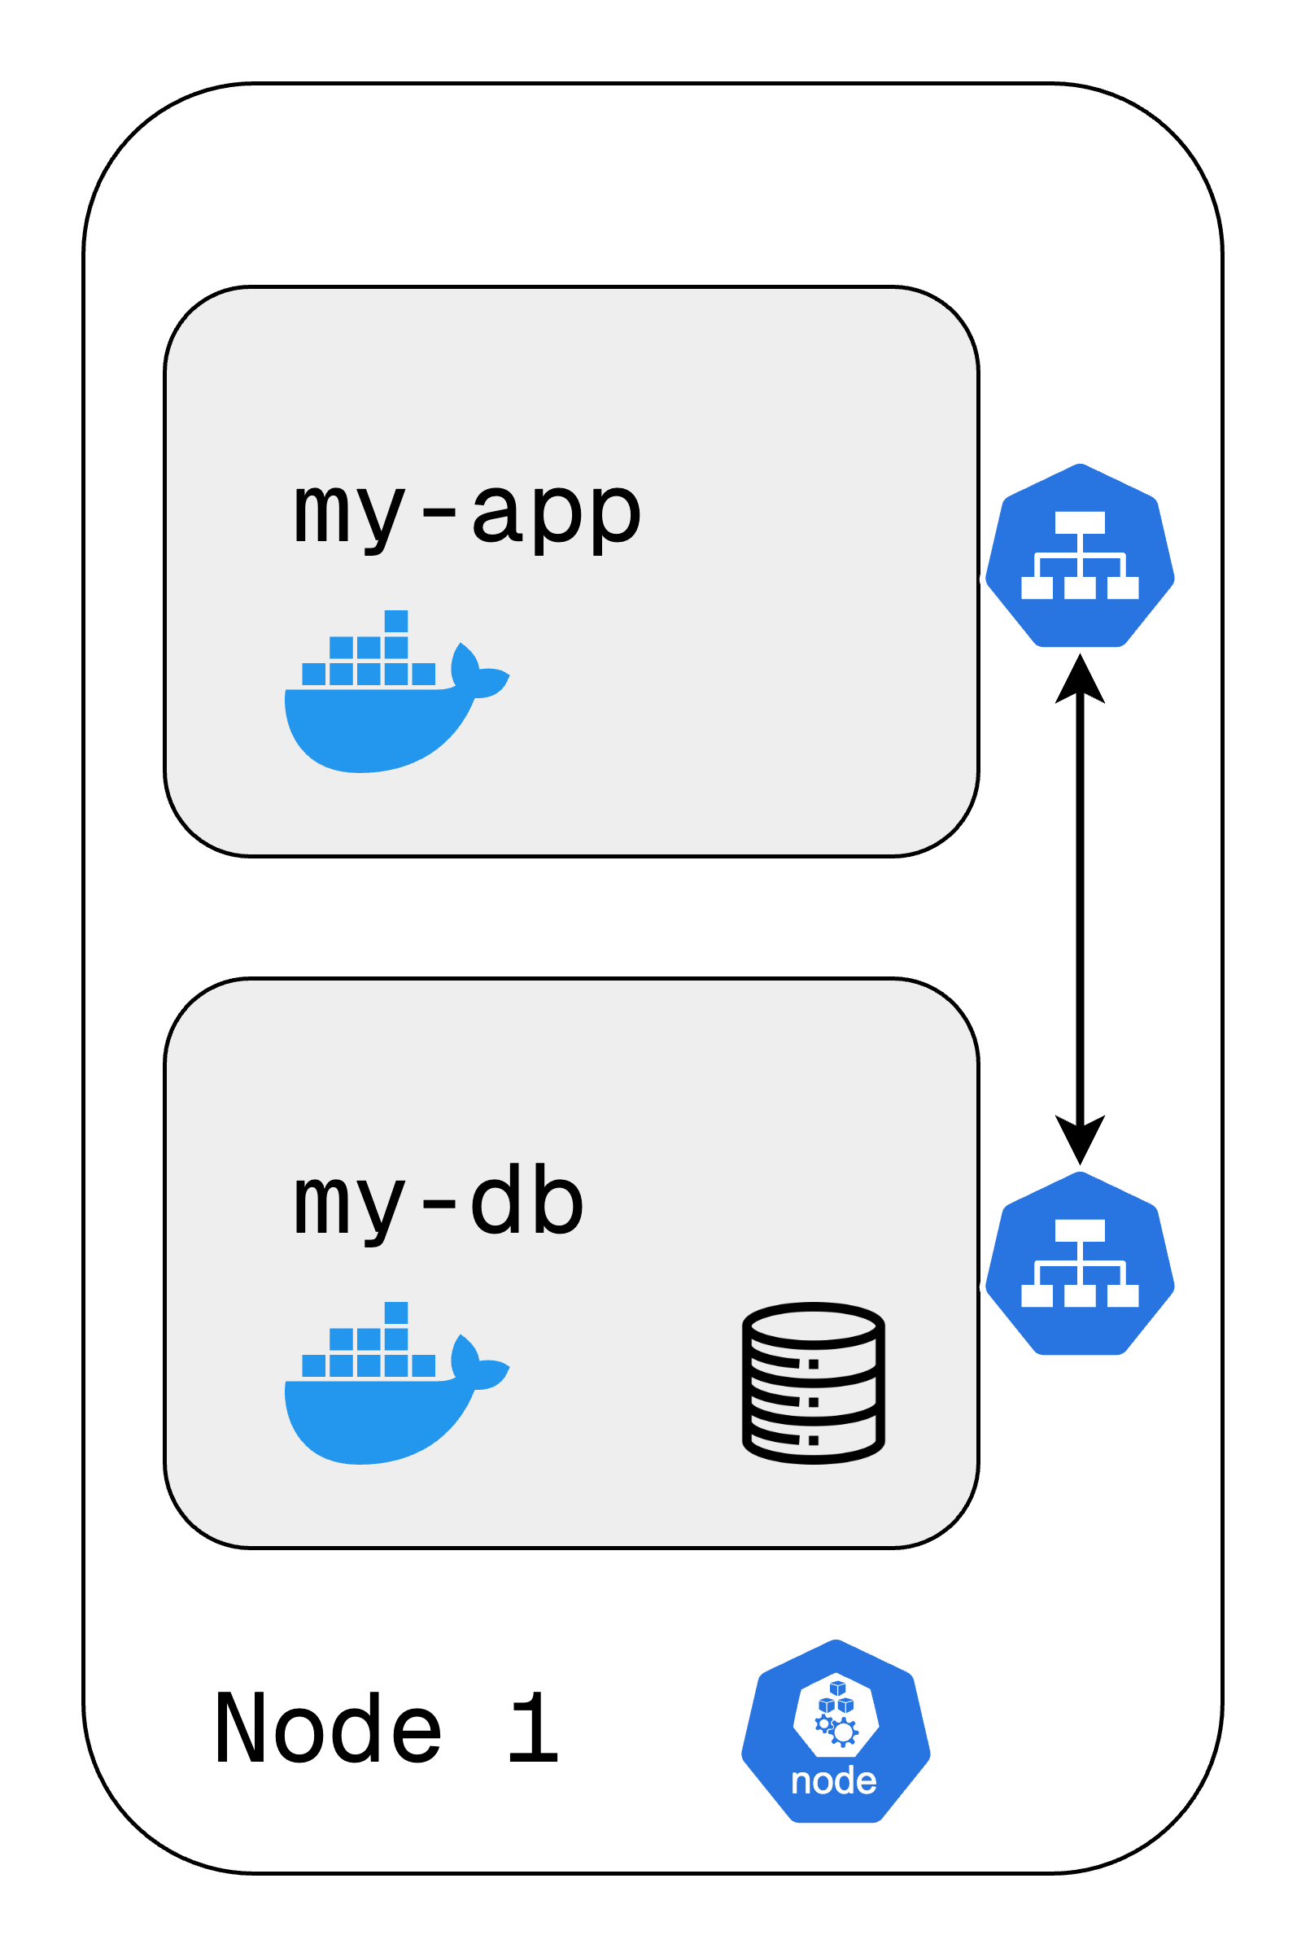
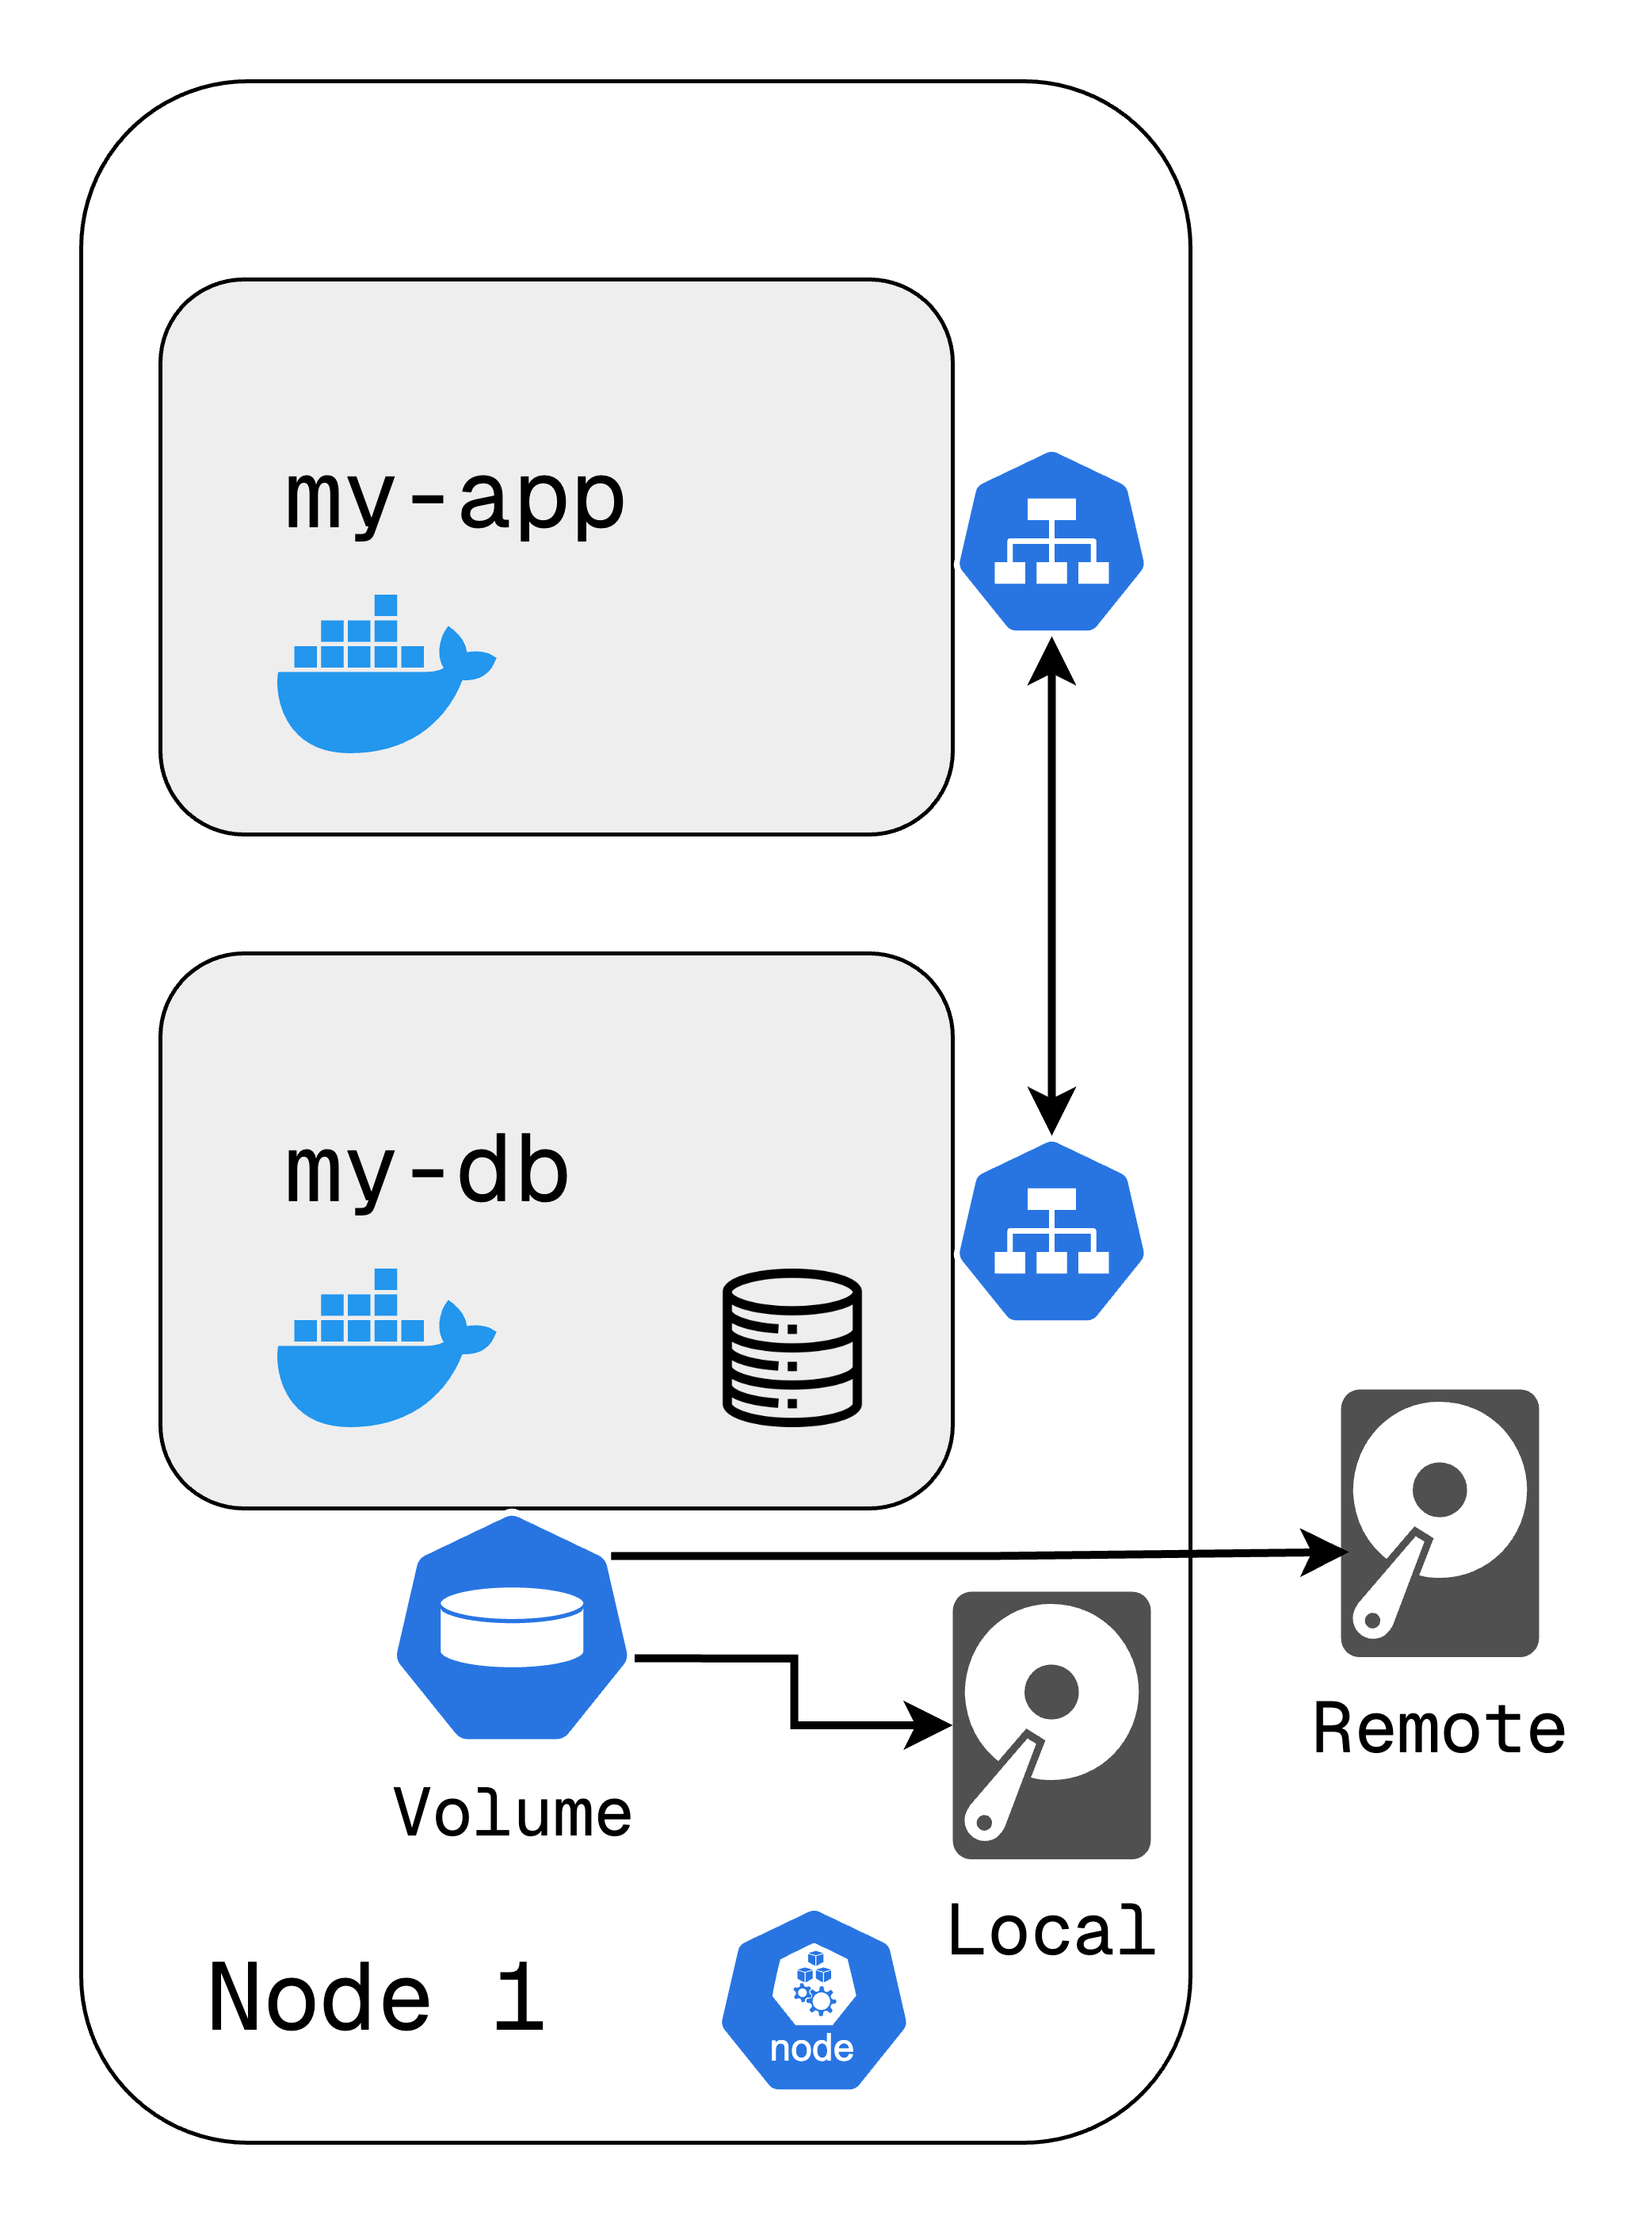
Volume
Containers are ephemeral i.e.; data is lost when a pod restarts.
Databases and logs need persistent storage across pod restarts.
Volume attaches external storage to a pod.
Types of storage:
Local Storage: On the same Kubernetes node.
Remote Storage: Cloud storage, networked drives (NFS, Ceph, etc.).
Kubernetes does not manage data persistence admins must handle backups.
https://tinyurl.com/k8resources
Notes:
1. Why Do We Need Volumes?
• By default, if a pod restarts, all data inside its container is lost.
• This is a major issue for applications that store data, like databases or logs.
• Kubernetes Volumes solve this by decoupling storage from containers.
2. How Kubernetes Volumes Work
• Kubernetes mounts a physical storage drive onto a pod.
• Storage can be local (on the same machine as the pod) or remote (on cloud storage or a dedicated server).
• This ensures that even if a pod crashes or restarts, data remains intact.
3 Key Takeaways
• Kubernetes itself does not manage persistent data - this is the user’s responsibility.
• Choosing between local and remote storage depends on availability, scalability, and backup needs.
• Kubernetes Volumes prevent data loss and enable fault tolerance in applications. Problem: What happens if a Pod crashes?
Right now, our application is running inside a single Pod. But what if that Pod crashes or we restart it due to an update?
The application would experience downtime, meaning users wouldn’t be able to access it until a new Pod is created.
In production, this is unacceptable—we need a solution that ensures high availability and zero downtime when updating or restarting Pods.

Slide 15
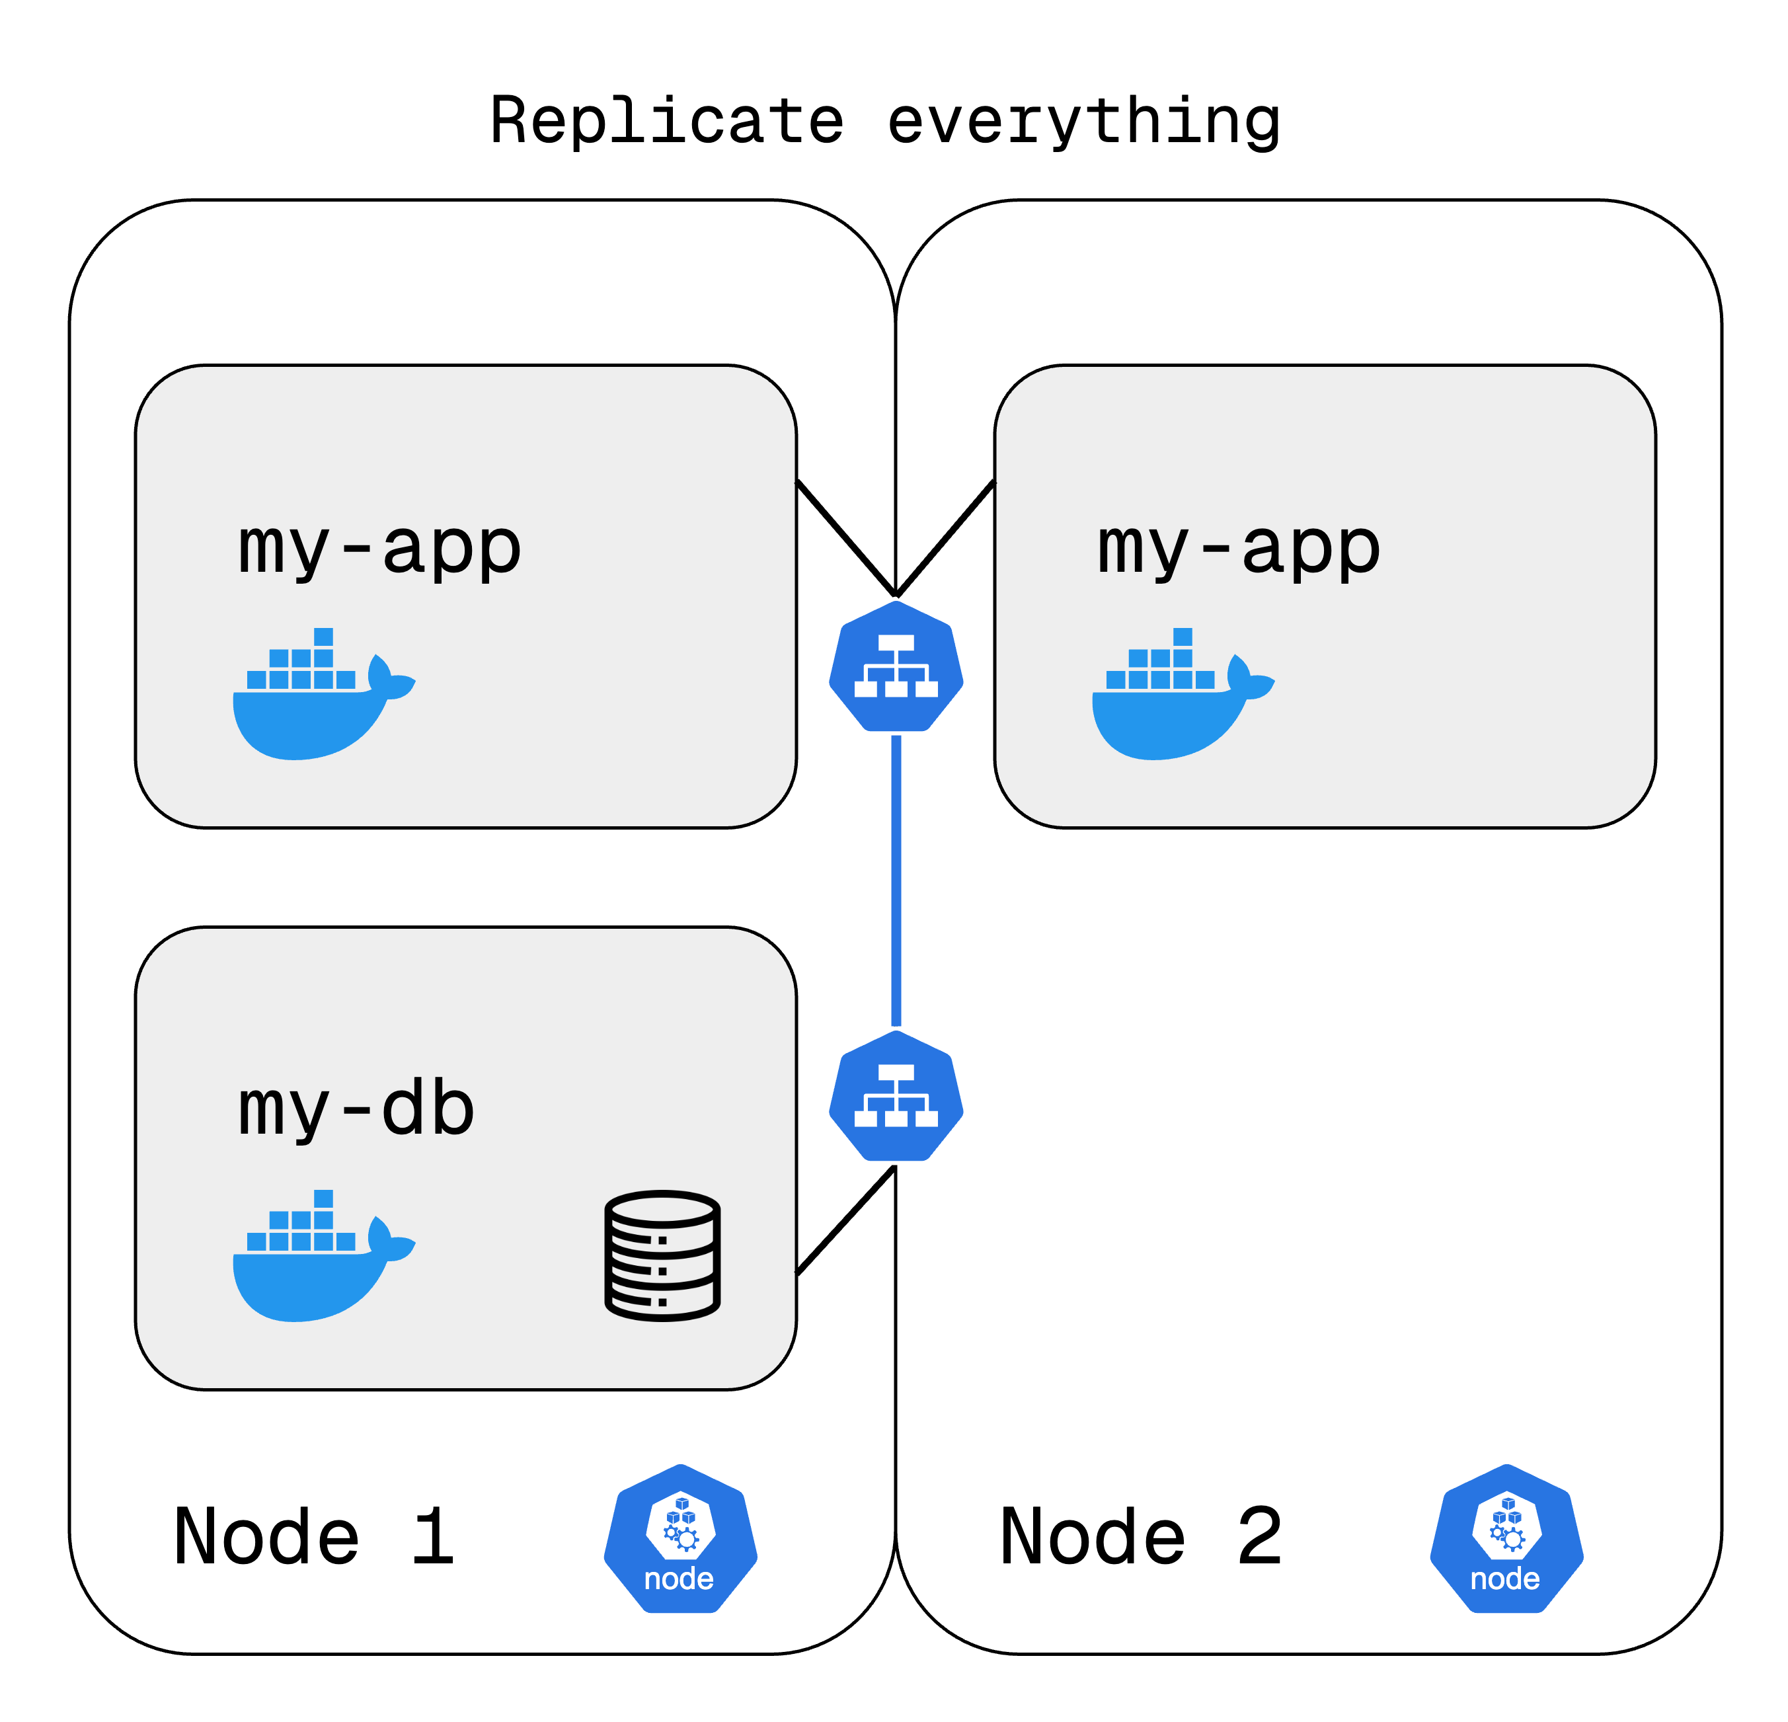
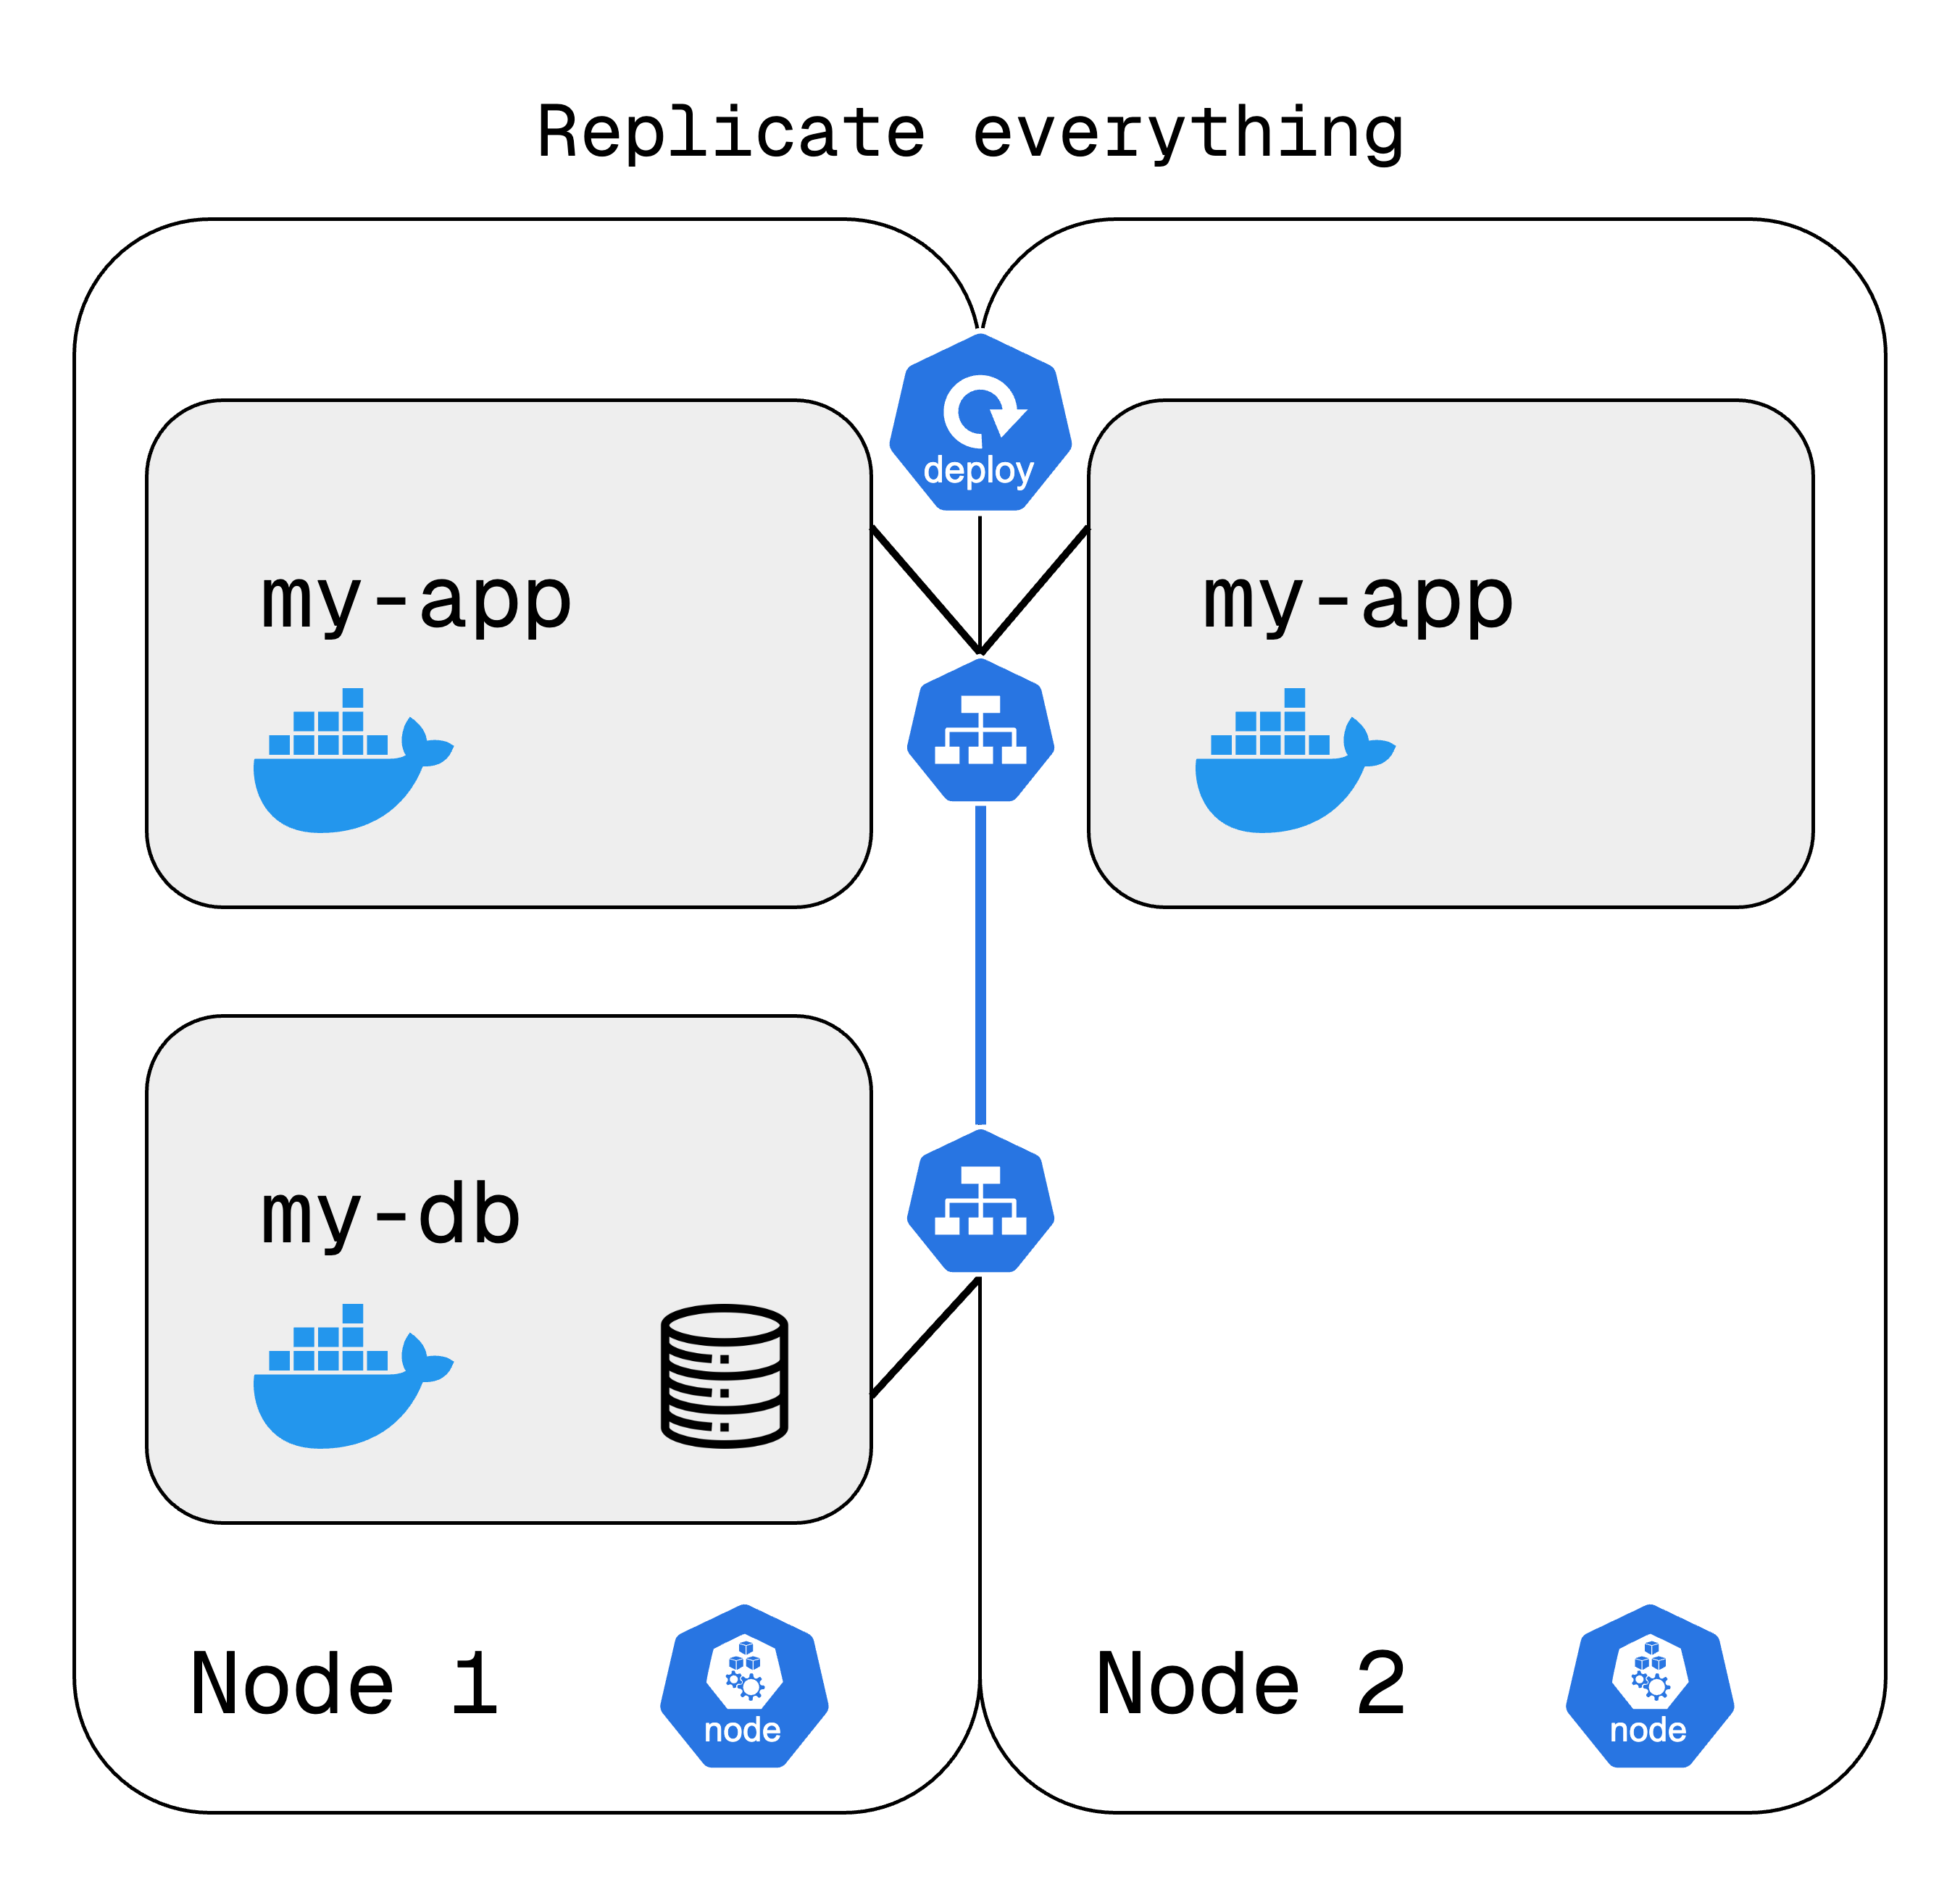
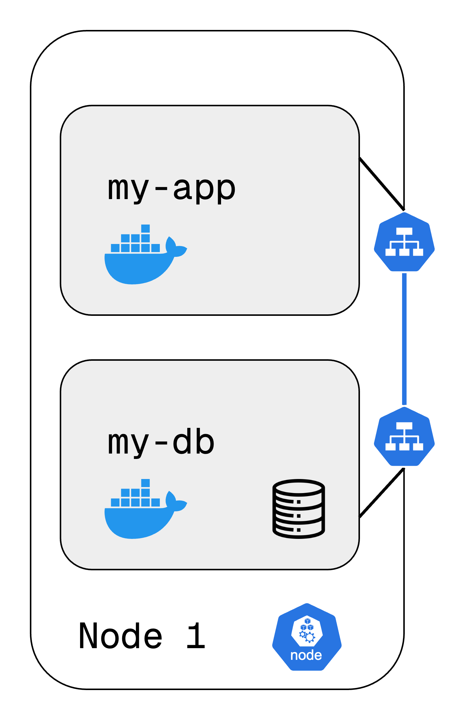
Deployment
A higher-level abstraction over Pods.
It defines desired state, Kubernetes ensures it. Allows replication, scaling, and rolling updates.
Why Use Deployments?
Ensures zero-downtime updates.
Automatically replaces failed pods.
Allows easy scaling up/down based on demand.
We define a Deployment with the number of replicas. Kubernetes creates & manages pods accordingly. Load balancer (Service) distributes traffic. If a pod crashes, a new one is created automatically.
Notes:
Problem: What happens if a Pod crashes?
Right now, our application is running inside a single Pod. But what if that Pod crashes or we restart it due to an update?
The application would experience downtime, meaning users wouldn’t be able to access it until a new Pod is created.
In production, this is unacceptable—we need a solution that ensures high availability and zero downtime when updating or restarting Pods.
Solution: Deployments
Instead of manually creating and managing Pods, we define a Deployment—a blueprint for how many replicas of a Pod should run at all times.
Kubernetes then automatically ensures the specified number of Pods are always running.
If one Pod crashes, Kubernetes creates a new one immediately, avoiding downtime.
How Deployments Help
We get automatic scaling—Kubernetes can increase or decrease replicas based on load.
Rolling updates allow us to update the application without downtime.
The Service (Load Balancer) ensures requests are distributed across running Pods, improving reliability.
In summary: Deployments make our application more resilient, scalable, and easier to manage, ensuring users never experience downtime due to Pod failures.
NOW Problem: What about databases?
• So far, Deployments work great for stateless applications like web servers—but what if we need to run a database inside Kubernetes?
• If we use a Deployment for a database, every replica would be an independent copy with its own data, causing data inconsistencies.
• When a Pod restarts, it may get assigned a new hostname or even lose its stored data.
• Databases need stable storage, consistent network identity, and data synchronization.

Slide 16
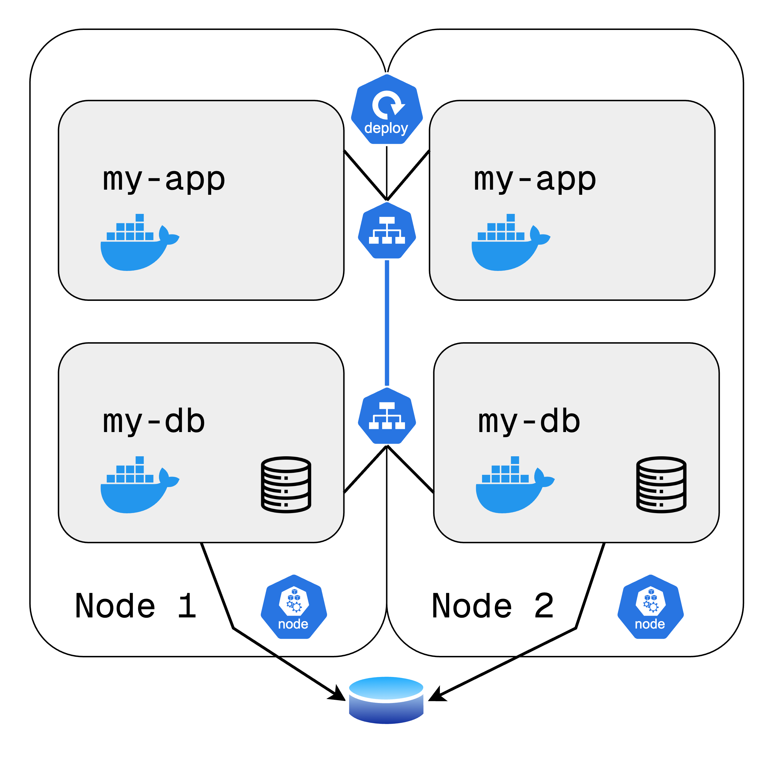
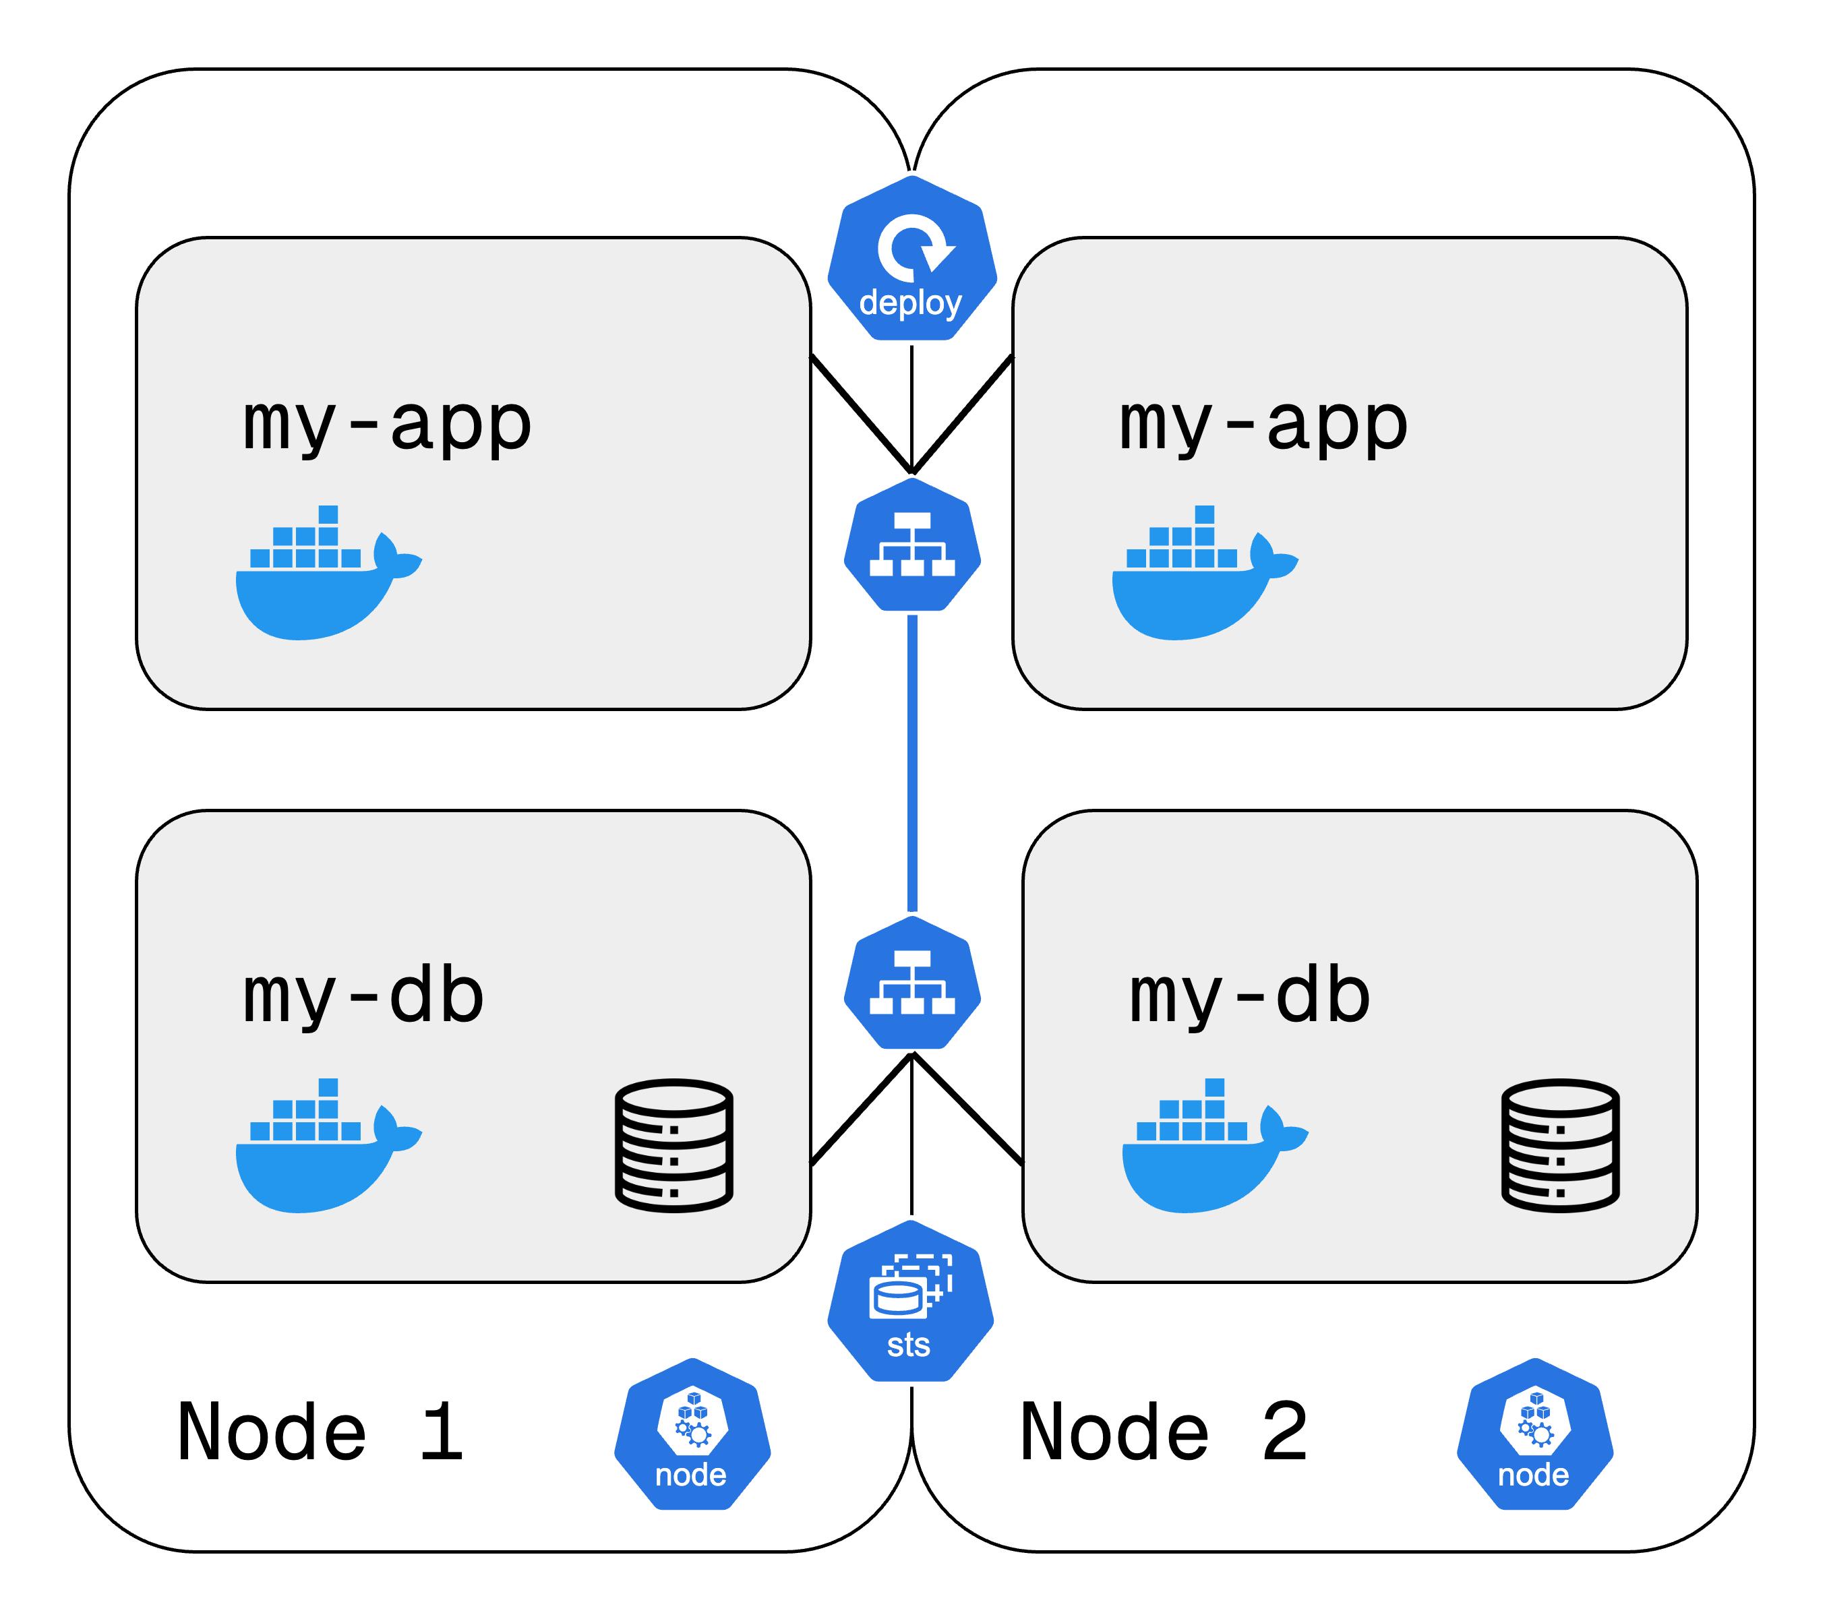
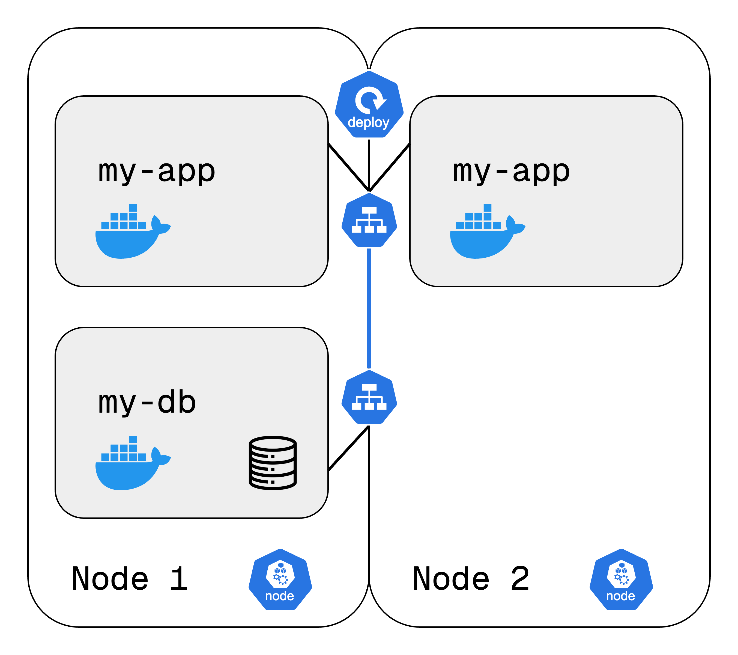
StatefulSet
Similar to Deployment but designed for stateful applications.
Used when data persistence and stable network identities are required (e.g., databases).
Unlike Deployments, each pod in a StatefulSet has a stable hostname and persistent storage.
Pods are created one at a time, in order, ensuring proper initialization.
Even if a pod is deleted, its storage and identity remain the same when recreated.
https://tinyurl.com/k8resources
Notes:
Problem: What about databases?
So far, Deployments work great for stateless applications like web servers—but what if we need to run a database inside Kubernetes?
If we use a Deployment for a database, every replica would be an independent copy with its own data, causing data inconsistencies.
When a Pod restarts, it may get assigned a new hostname or even lose its stored data.
Databases need stable storage, consistent network identity, and data synchronization.
Solution: StatefulSets
A StatefulSet ensures each database replica has a fixed identity and persistent storage.
If a database Pod crashes, Kubernetes recreates it with the same hostname and reattaches its storage, ensuring data is not lost.
Unlike Deployments, where Pods are created in parallel, StatefulSets create Pods one by one in a controlled manner to avoid conflicts.
Why is this important?
For databases like MySQL, MongoDB, or Elasticsearch, multiple replicas must read and write to the same shared data storage.
StatefulSets ensure that writes are properly synchronized, preventing corruption or inconsistencies.
However, managing databases inside Kubernetes is complex, so many teams choose to host databases outside Kubernetes while keeping only stateless application components inside.
In summary: StatefulSets are the right choice for stateful applications, ensuring data consistency, persistence, and stable networking, making them essential for running databases inside Kubernetes.
EXTRA CONTENT FOR SLIDE
Why Not Use Deployments
Deployments work well for stateless applications (e.g., web servers) but cannot handle persistent data.
If a database pod is restarted in a Deployment, it may lose its data.
StatefulSets ensure that data is always available, preventing loss.

Slide 17
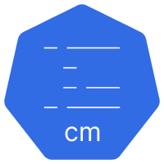
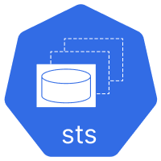
Summary
Abstraction of containers
Communication
Route traffic into cluster
External configuration
Persistence
Pod blueprints with replication mechanisms
Notes:
Now, we go into the
Quiz
Or
Kubernetes architecture

Slide 18
Quiz

Slide 19
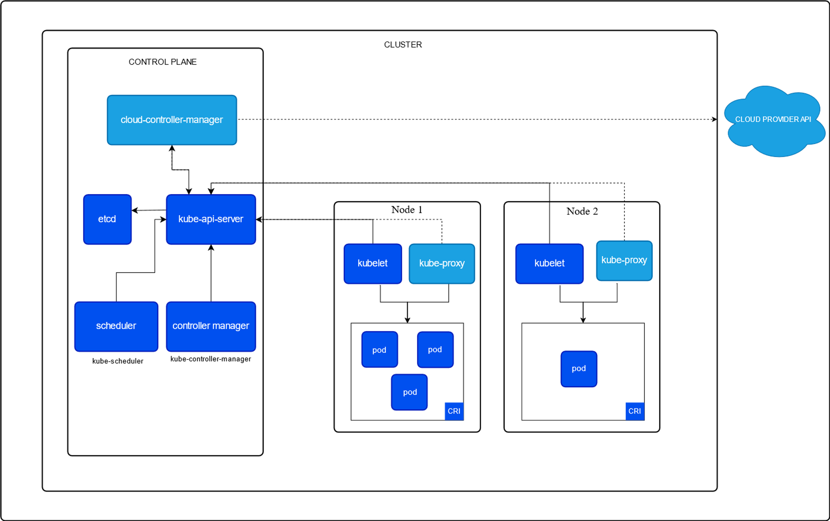
Architecture of Kubernetes
These are the components of a Kubernetes cluster.
etcd
kube-api-server
kube-scheduler
kube-controller-manager
kubelet
kube-proxy
https://tinyurl.com/k8resources
Notes:
etcd: Key-value store used for storing all cluster data. It serves as the source of truth for the cluster state and configuration.
kube-apiserver: The front end for the Kubernetes control plane.
kube-scheduler: Schedules pods onto the appropriate nodes based on resource availability and other constraints.
kube-controller-manager: Runs controller processes. Each controller is a separate process that manages routine tasks such as maintaining the desired state of resources, managing replication, handling node operations, etc...
cloud-controller-manager: Integrates with the underlying cloud provider (if running in one) to manage cloud-specific resources. It handles tasks such as managing load balancers, storage, and networking.
kubelet: An agent that runs on each worker node and ensures that containers are running in pods and manages the lifecycle of containers.
kube-proxy: This network proxy runs on each node and maintains network rules to allow communication to and from pods.

Slide 20
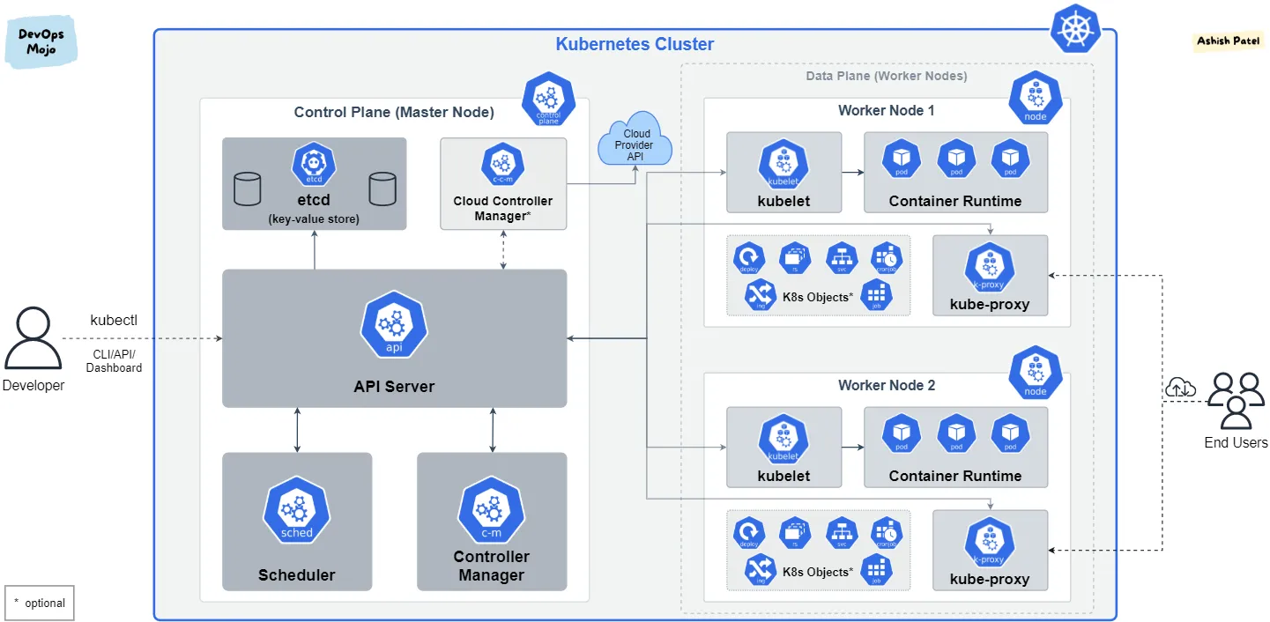
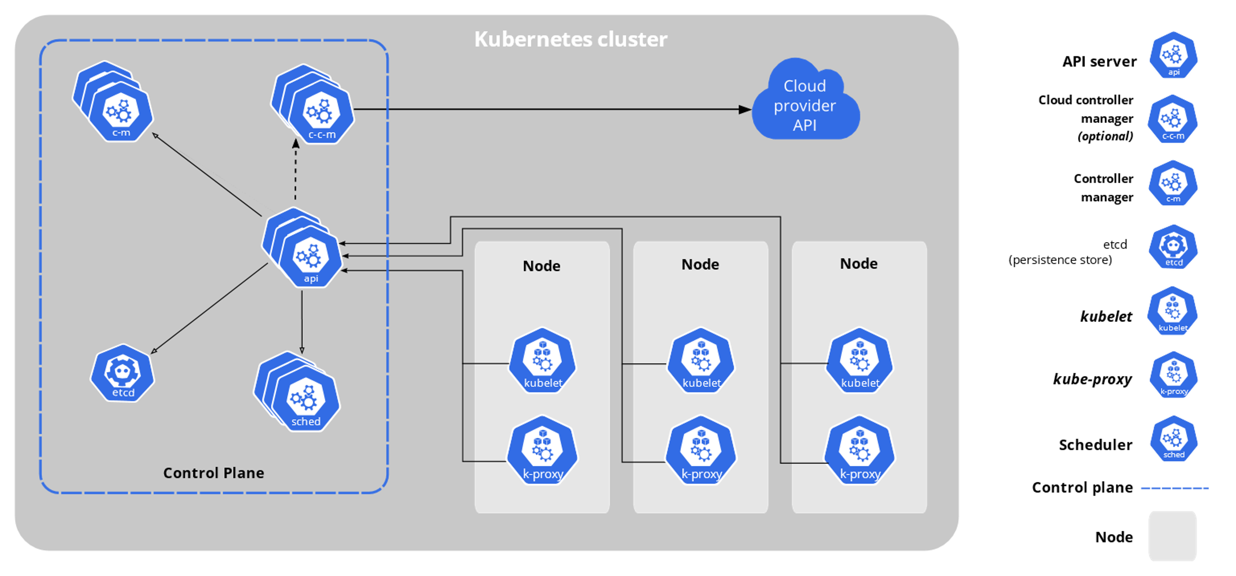
Notes:
From https://medium.com/devops-mojo/kubernetes-architecture-overview-introduction-to-k8s-architecture-and-understanding-k8s-cluster-components-90e11eb34ccd

Slide 21
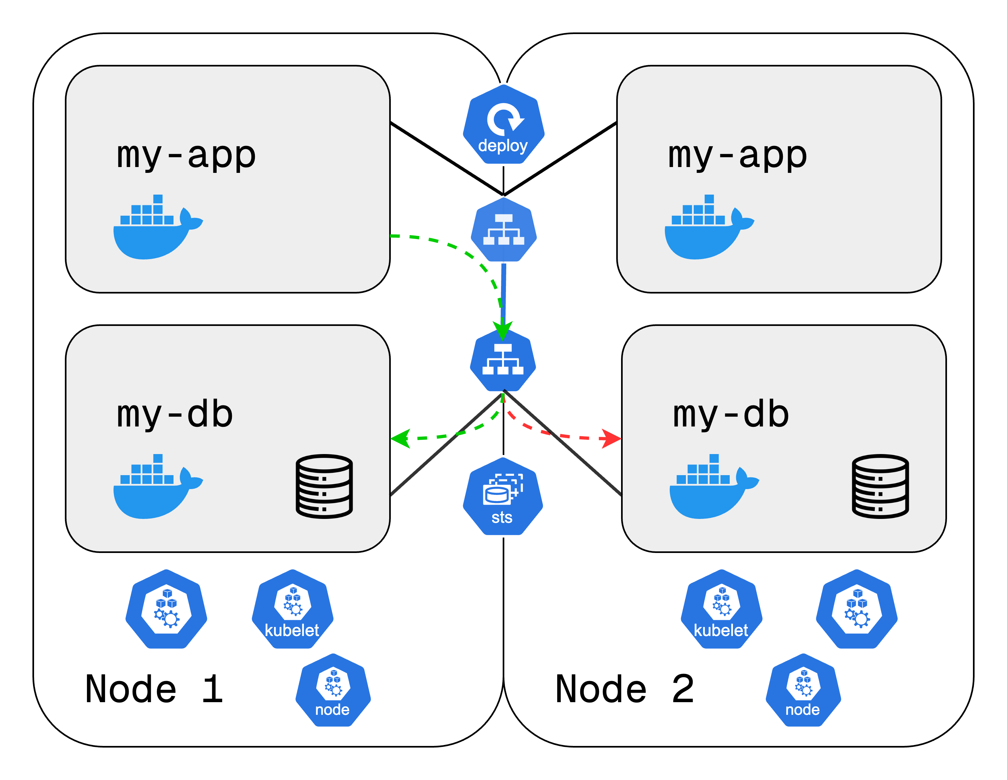
Worker Node in K8 cluster
Run application Pods and manage workloads.
Three key components of a Worker Node:
Container Runtime: Runs containers inside Pods.
kubelet: Communicates with the Kubernetes control plane. Ensures Pods are running and assigns resources (CPU, RAM, storage).
kube-proxy: Manages network communication between Pods and Services. Optimizes request routing to reduce network overhead.
Kubernetes clusters have multiple worker nodes for scalability.
Services act as a load balancer to distribute traffic efficiently.
kube-proxy intelligently forwards requests to improve performance.
Notes:
Problem: How do worker nodes function in a Kubernetes cluster?
• In Kubernetes, worker nodes are the backbone—they run the application Pods and handle actual workloads.
• But how do these nodes manage Pods efficiently? How do they ensure smooth communication?
• Kubernetes relies on three key components on each worker node to enable smooth scheduling, resource allocation, and networking.
Solution: Three Key Components of a Worker Node
1. Container Runtime (e.g., Docker, containerd)
• Since Kubernetes runs applications as containers, each node needs a container runtime.
• This is responsible for running the actual containers inside the Pods.
• Kubernetes supports multiple runtimes, but Docker and containerd are the most common.
2. Kubelet (Core Kubernetes Agent)
• This is a Kubernetes process that runs on each worker node.
• It takes instructions from the control plane and ensures that the desired Pods are running.
• It also assigns resources like CPU, RAM, and storage to the containers inside Pods.
3. Kube-Proxy (Network Management)
• Ensures smooth communication between different Pods and Services.
• Acts as a network proxy and load balancer, forwarding requests efficiently.
• It also optimizes network traffic by routing requests to Pods on the same node whenever possible, reducing network overhead.
Scalability & Efficient Communication
• A Kubernetes cluster typically has multiple worker nodes running application Pods.
• Each node has these three components to enable automation, scaling, and load balancing.
• Services are used to route traffic to the right Pods, while Kube-Proxy ensures requests are handled efficiently.
Summary
• Worker nodes execute workloads and must have container runtime, Kubelet, and Kube-Proxy installed.
• Kubelet ensures Pods run as expected and manage resources.
• Kube-Proxy optimizes network traffic and routes requests effectively.
• This setup allows Kubernetes clusters to scale efficiently while keeping workloads running smoothly.
now the question is
How do you interact with this cluster?
How do you decide on which node a new application pod or database pod should be scheduled
If a replica part dies what process actually monitors it and then reschedules it or restarts it again
When we add another server how does it join the cluster to become another node and get pods and other components created on it?
And the answer is all these - managing processes are done by Master nodes

Slide 22
How do you interact with this cluster?
How to
Schedule a pod
Monitor a pod
Re-schedule/restart a pod
Join a new node
https://tinyurl.com/k8resources
Notes:
now the question is
How do you interact with this cluster?
How do you decide on which node a new application pod or database pod should be scheduled
If a replica part dies what process actually monitors it and then reschedules it or restarts it again
When we add another server how does it join the cluster to become another node and get pods and other components created on it?
And the answer is all these – managing all these processes are done by Control Plane nodes

Slide 23
Control Plane Processes
Control Plane controls and manages the entire Kubernetes cluster. It ensures Pods are scheduled, running, and restarted if needed.
Control Plane components:
kube-apiserver: Core component server that exposes the Kubernetes HTTP API. The entry point for all Kubernetes operations.
kube-scheduler: Looks for pods not yet bound to a node and assigns each Pod to a suitable node.
kube-controller-manager: Runs controllers to implement Kubernetes API behavior i.e., it ensures cluster stability and self-healing.
etcd: Consistent and highly-available key value store for all API Server data. It stores the cluster state and configuration.
cloud-controller-manager (optional): Integrates with underlying cloud provider(s).
kubelet in worker nodes
Notes:
API Server:
The API Server is the primary way to interact with a Kubernetes cluster.
Whether you’re deploying a new application, scaling pods, or checking cluster health, your request must go through the API Server.
It doesn’t perform scheduling or start containers itself; instead, it validates the request and forwards it to other components like the Scheduler or Controller Manager.
Since all requests pass through the API Server, it also acts as a security gateway, ensuring that only authorized users or processes can modify the cluster.
Scheduler:
When a new Pod needs to be deployed, how does Kubernetes decide which node should run it? That’s the job of the Scheduler.
The API Server sends the request, and the Scheduler evaluates all worker nodes to find the best match based on resource availability (CPU, RAM, etc.).
It doesn’t actually start the container—it just decides where it should go. The Kubelet on the assigned node then executes the deployment.
Without the Scheduler, Pods might be randomly assigned, causing overloading on some nodes and wasted resources on others.
Controller Manager:
In a distributed system, failures are inevitable. What happens if a Pod crashes or a node goes offline?
That’s where the Controller Manager comes in—it constantly monitors the cluster’s health and takes action when things go wrong.
If a Pod dies, the Controller Manager detects the failure and tells the Scheduler to recreate it on a healthy node.
It also ensures that replica sets are maintained, meaning if you specify three replicas of an application, it keeps checking that they are always running.
etcd
Where does Kubernetes store all its data? How does it know which Pods exist, which nodes are running, or which applications are deployed?
The answer is etcd—it’s a highly available, distributed key-value store that acts as the cluster’s brain.
Every action in Kubernetes—whether scheduling a new Pod, detecting failures, or querying cluster health—relies on etcd to store and retrieve information.
If etcd fails, the entire cluster loses its state, so in practice, Kubernetes clusters often replicate etcd across multiple Master nodes for reliability.

Slide 24
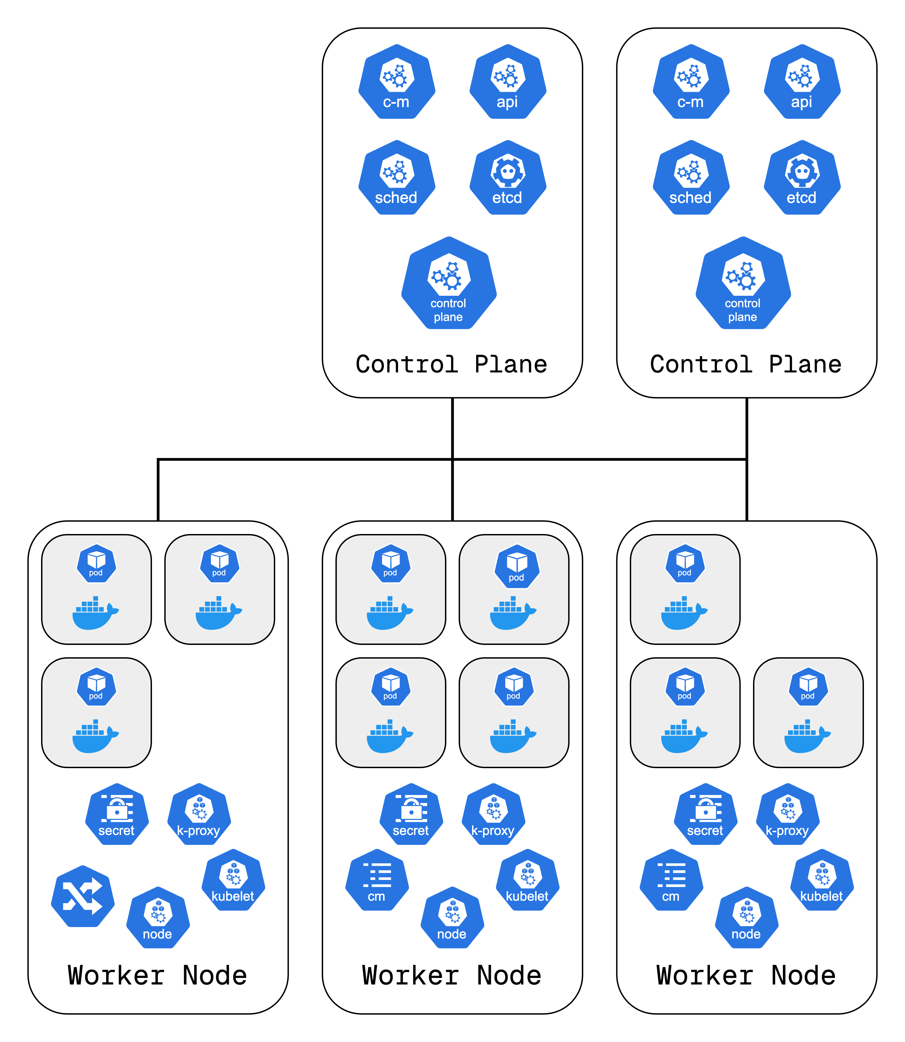
An example Cluster setup
Minimum cluster setup recommended in the production:
2 control plane nodes
3 worker nodes
But the recommended is:
3 control plane nodes
5 worker nodes
https://tinyurl.com/k8resources

Slide 25
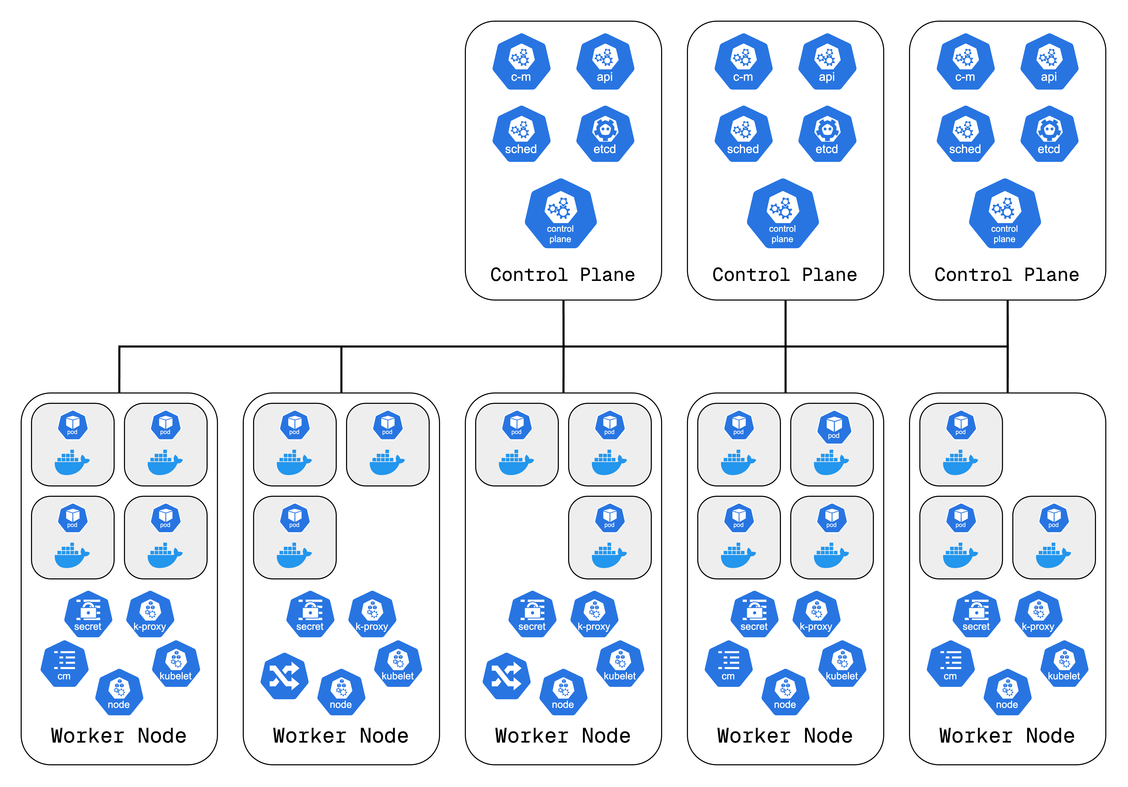

Slide 26
Hands on with Kubectl and minikube

Slide 27
minikube
kubectl
minikube quickly sets up a local Kubernetes cluster on macOS, Linux, and Windows.
As we cannot provision separate virtual or physical machines for each worker node, control plane node, minikube comes to our rescue.
It runs both the worker processes and control plane processes in ONE NODE.
It creates a virtual box using the hypervisor and the node runs in that virtual box.
Essentially, it is 1 node K8 cluster.
The main entry point into the Kubernetes cluster is the kube-api-server.
We can interact with it through UI, API or CLI.
kubectl is the most powerful of all the 3 clients.
Guide to install minikube: https://minikube.sigs.k8s.io/docs/start
https://tinyurl.com/k8resources

Slide 28
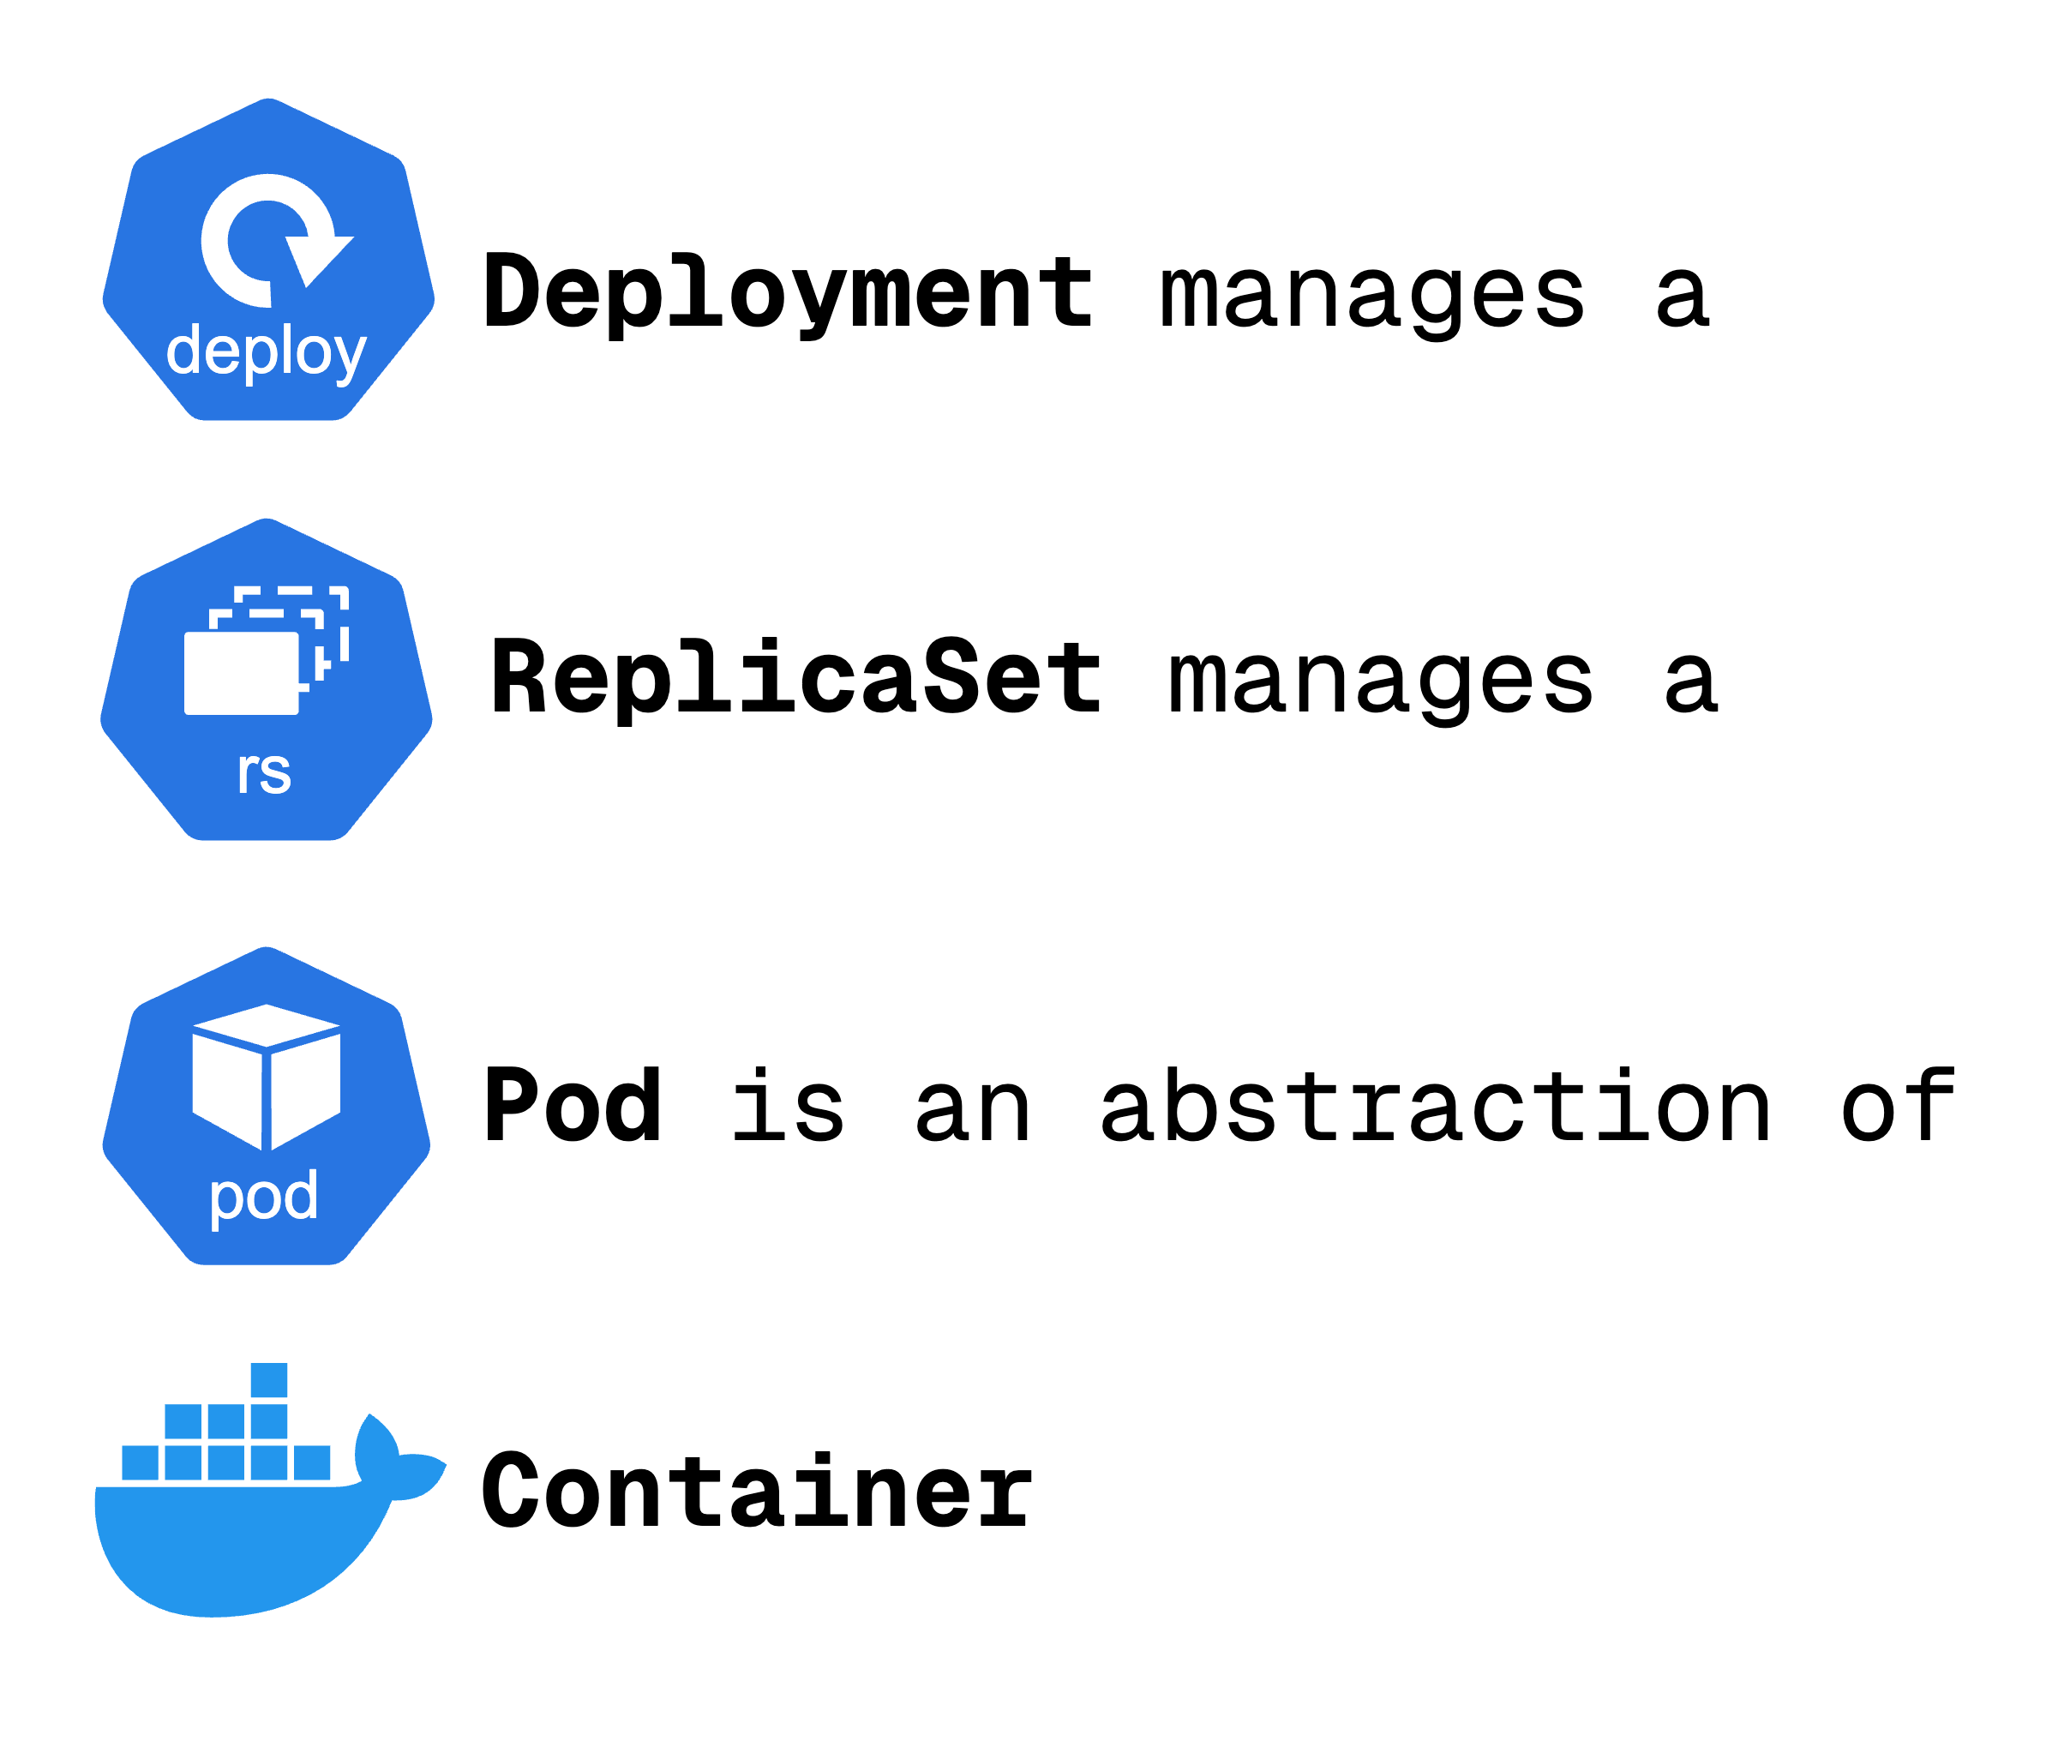

Slide 29
What we learnt?
CRUD commands
Status of different K8 components
Debugging pods
Use configuration file for CRUD

Slide 30
Understanding yaml configuration files in k8s

Slide 31
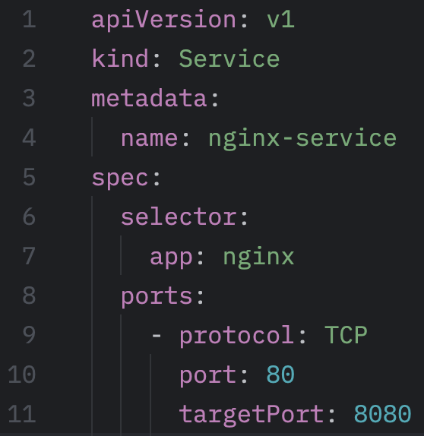
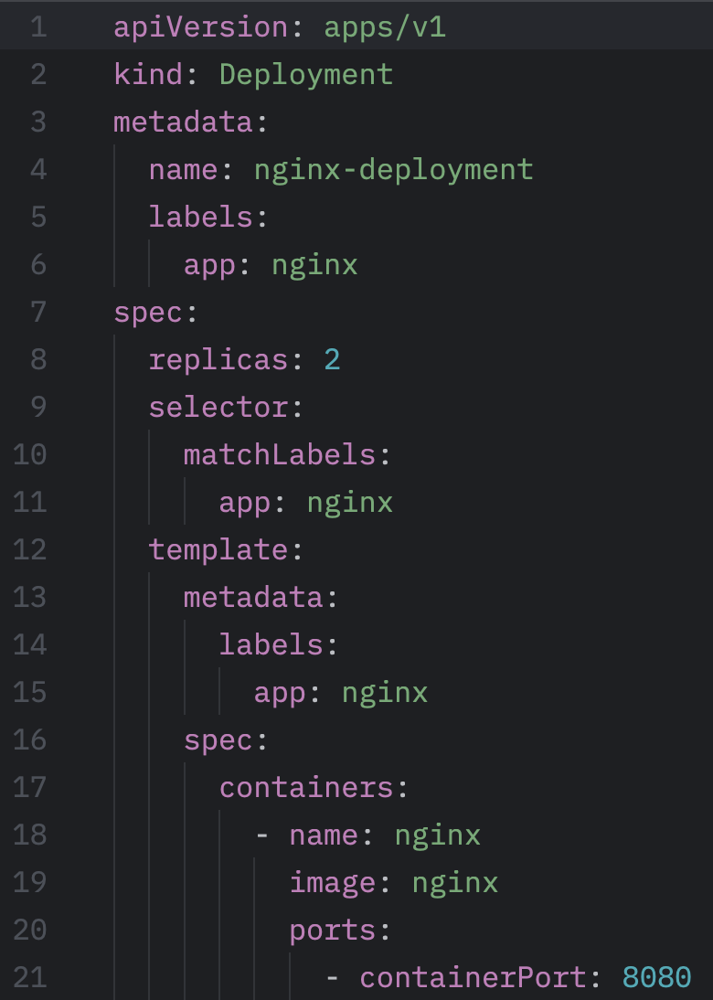
Configuration Files
Metadata
Specification
Attributes are specific to the kind of the resource the configuration file is describing
Status
This is automatically generated and edited by Kubernetes.
nginx-service.yaml
Desired ≠ Actual
Self healing property of Kubernetes
Updates the deployment
nginx-deployment.yaml

Slide 32
Understanding the YAML File
Deployment manages the Pod
We have a template in the
specification part of the configuration
file.
Template has its own metadata and
specification.
This is a blueprint for the pod.
Pod gets the label through the template blueprint. The label is matched by the selector.
https://tinyurl.com/k8resources
Notes:
Explain
the various parts of the deployment file in detail.
How the label is matched by selector (of pod, and deployment as well).
How the container port number is configured.
Demo
Apply the deployment, service.
Show the services, describe the service.
Show the list of pods in wide output mode.
Show how you can save the output of the deployment to a yaml file (k get deployment <name> -o yaml > nginx-depl-result.yaml)
Show the difference between the autogenerated one and the one you used to deploy
Show how you can simply delete the deployment using the configuration file.

Slide 33
Demo project

Slide 34
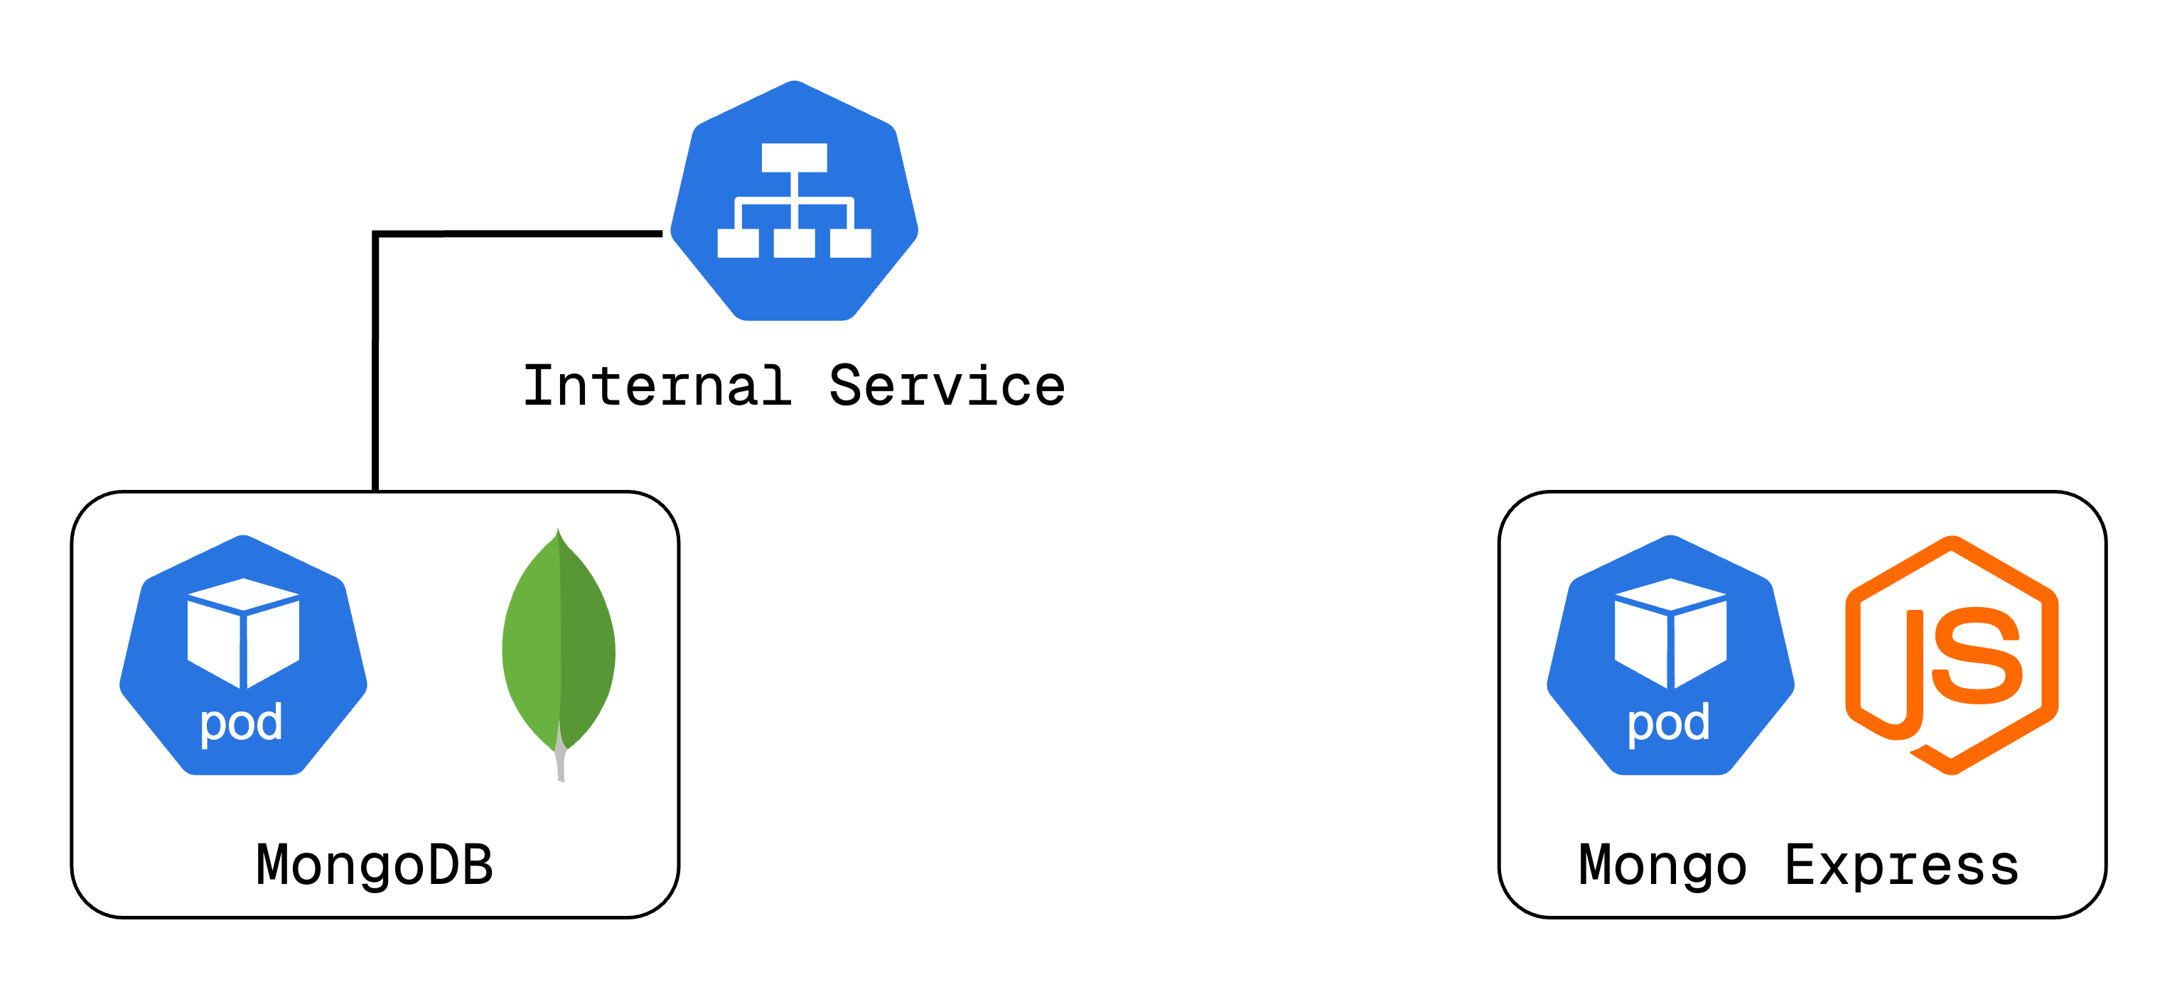
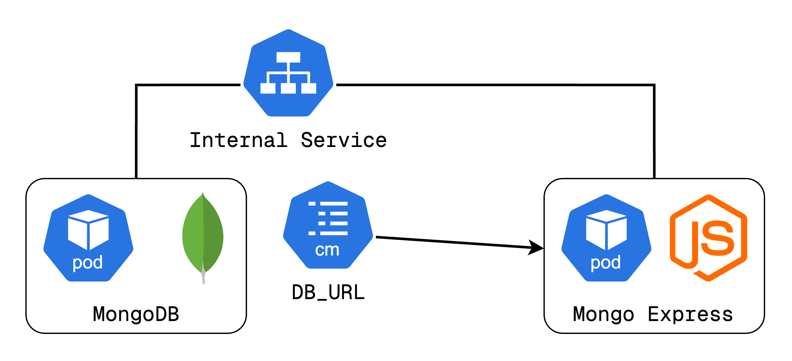
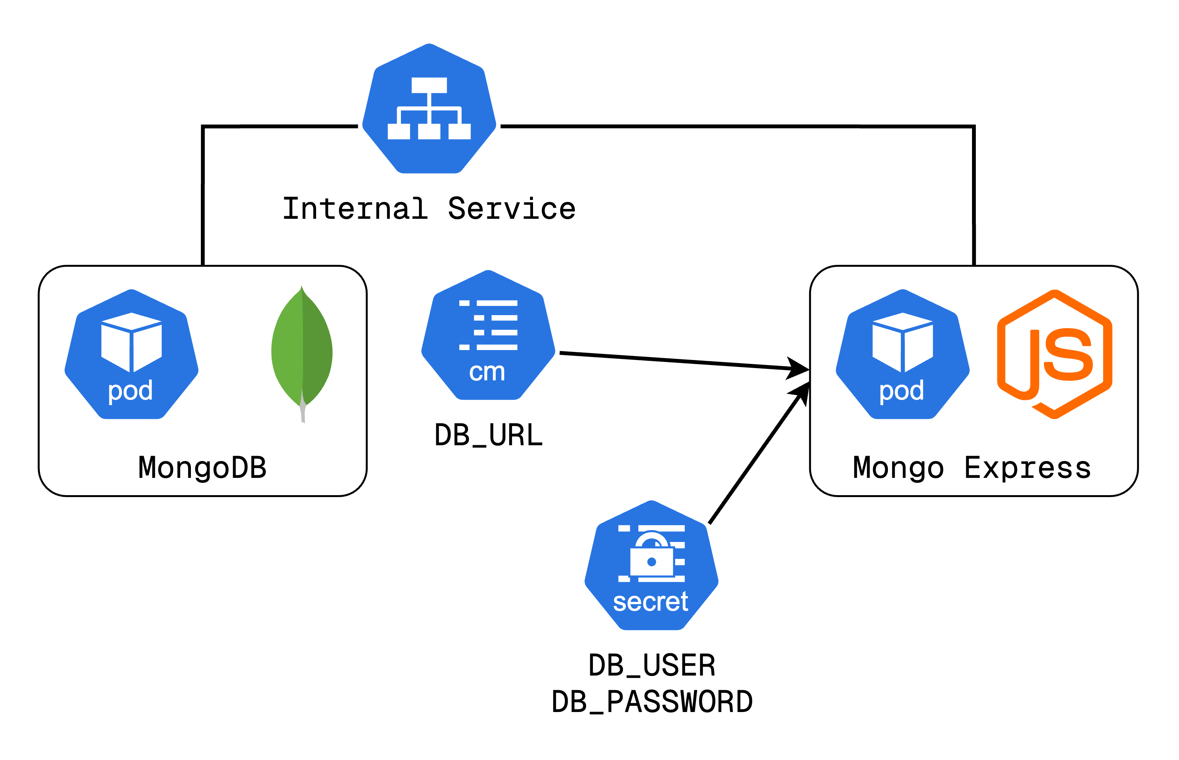
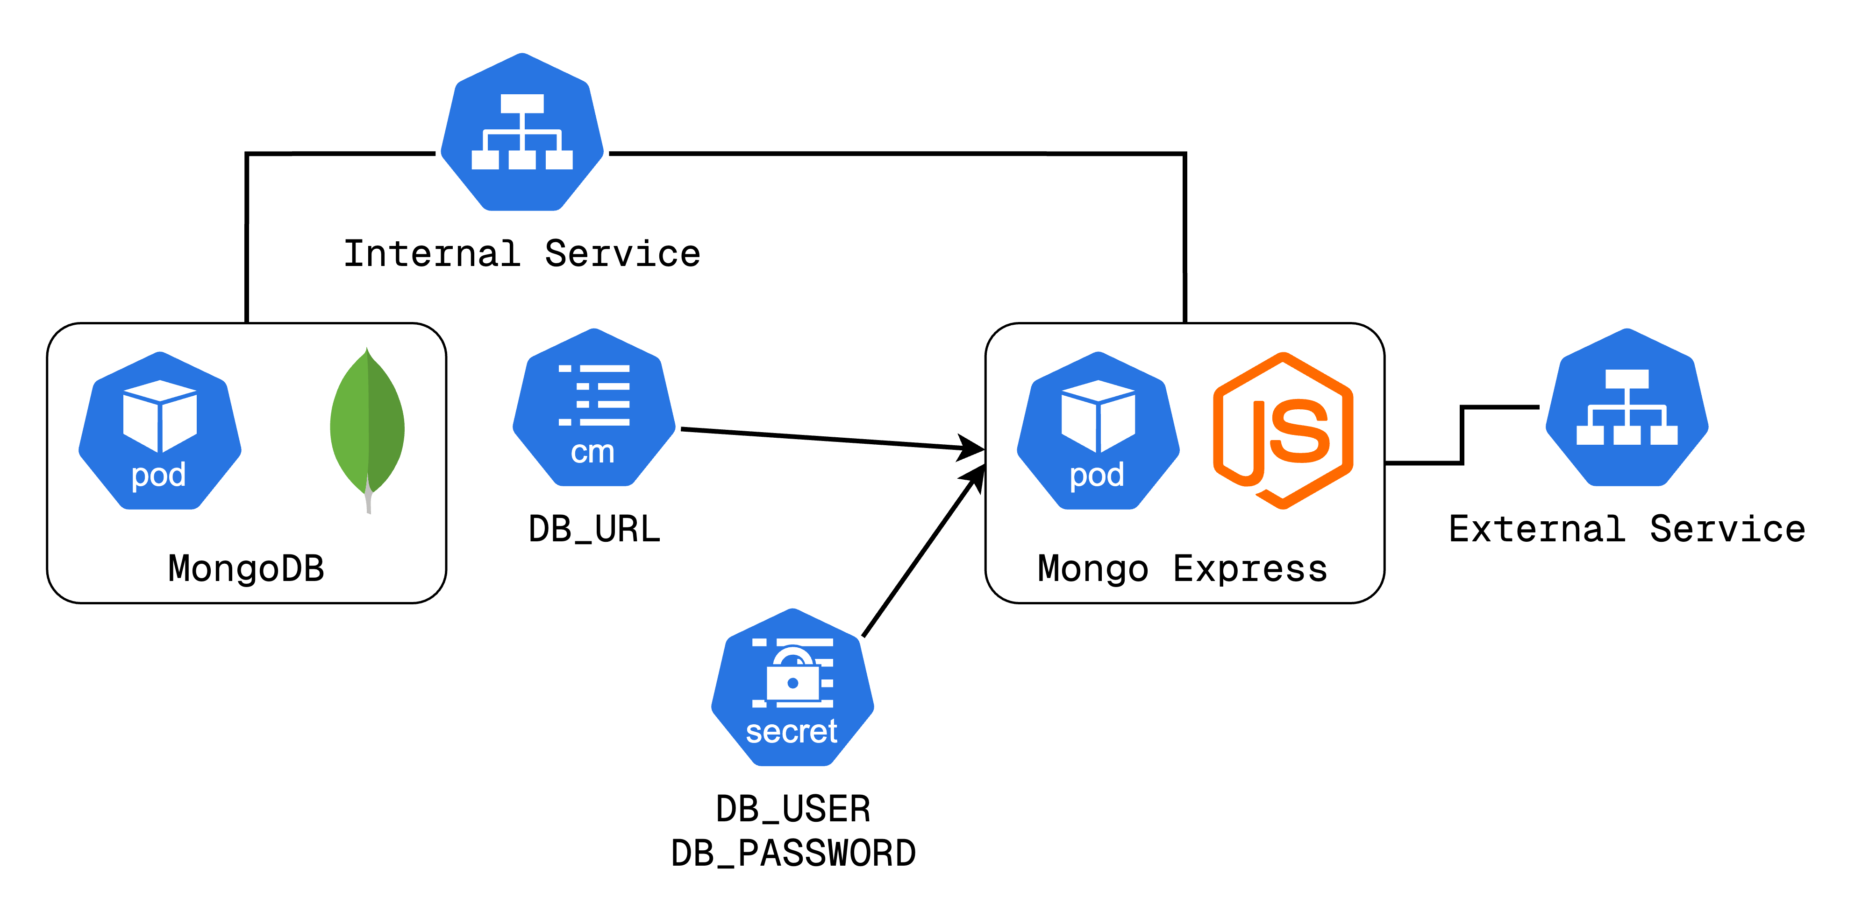
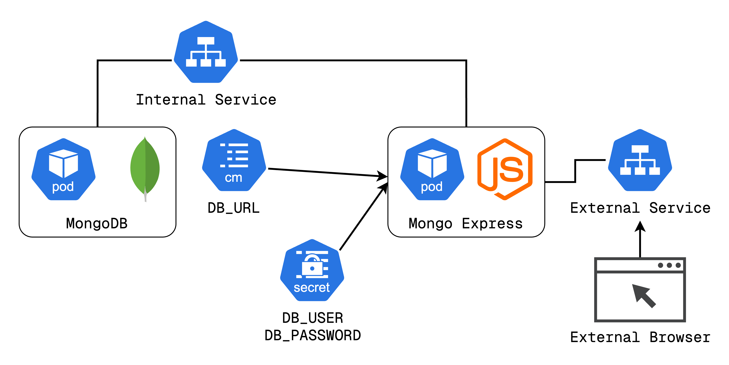

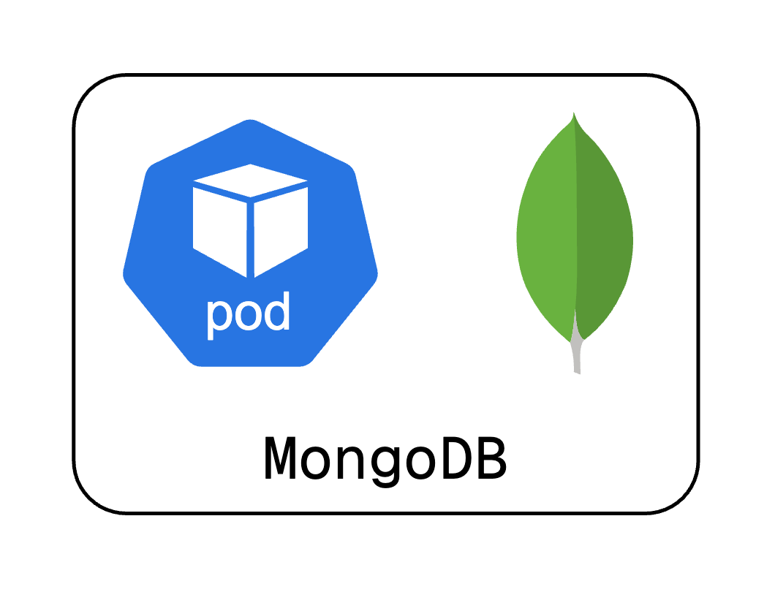
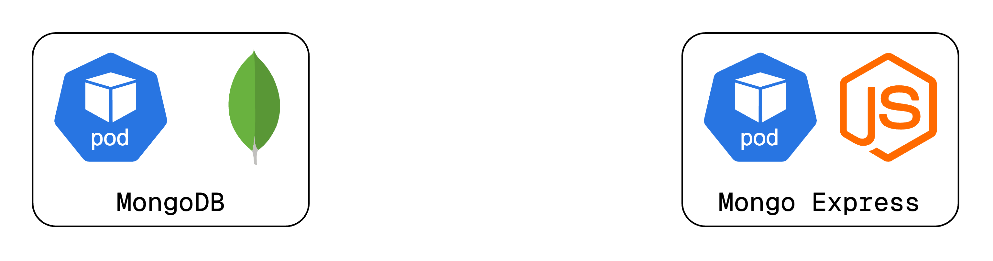
Application setup with K8s components
https://tinyurl.com/k8demo
2 Deployments (Pods)
2 Services
1 ConfigMap
1 Secret

Slide 35
Kubernetes namespaces

Slide 36
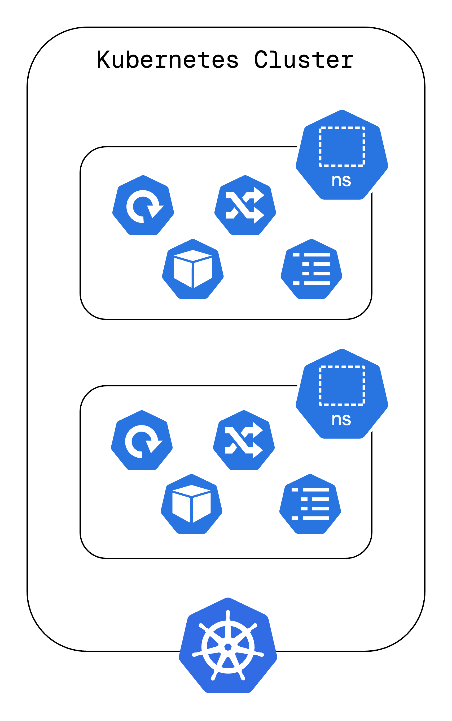
What is a Namespace?
Organize resources within a Kubernetes Cluster.
It is like a virtual cluster inside a Kubernetes cluster.
Multiple namespaces can exist within a single cluster.
Kubernetes has 4 namespaces by default
https://tinyurl.com/k8resources
Notes:
n Kubernetes, namespaces allow you to logically separate resources inside a single cluster. Think of them as virtual clusters that help organize and manage resources efficiently. Instead of cramming everything into a single space, namespaces let you separate workloads, making them easier to manage. Kubernetes comes with a few built-in namespaces.

Slide 37
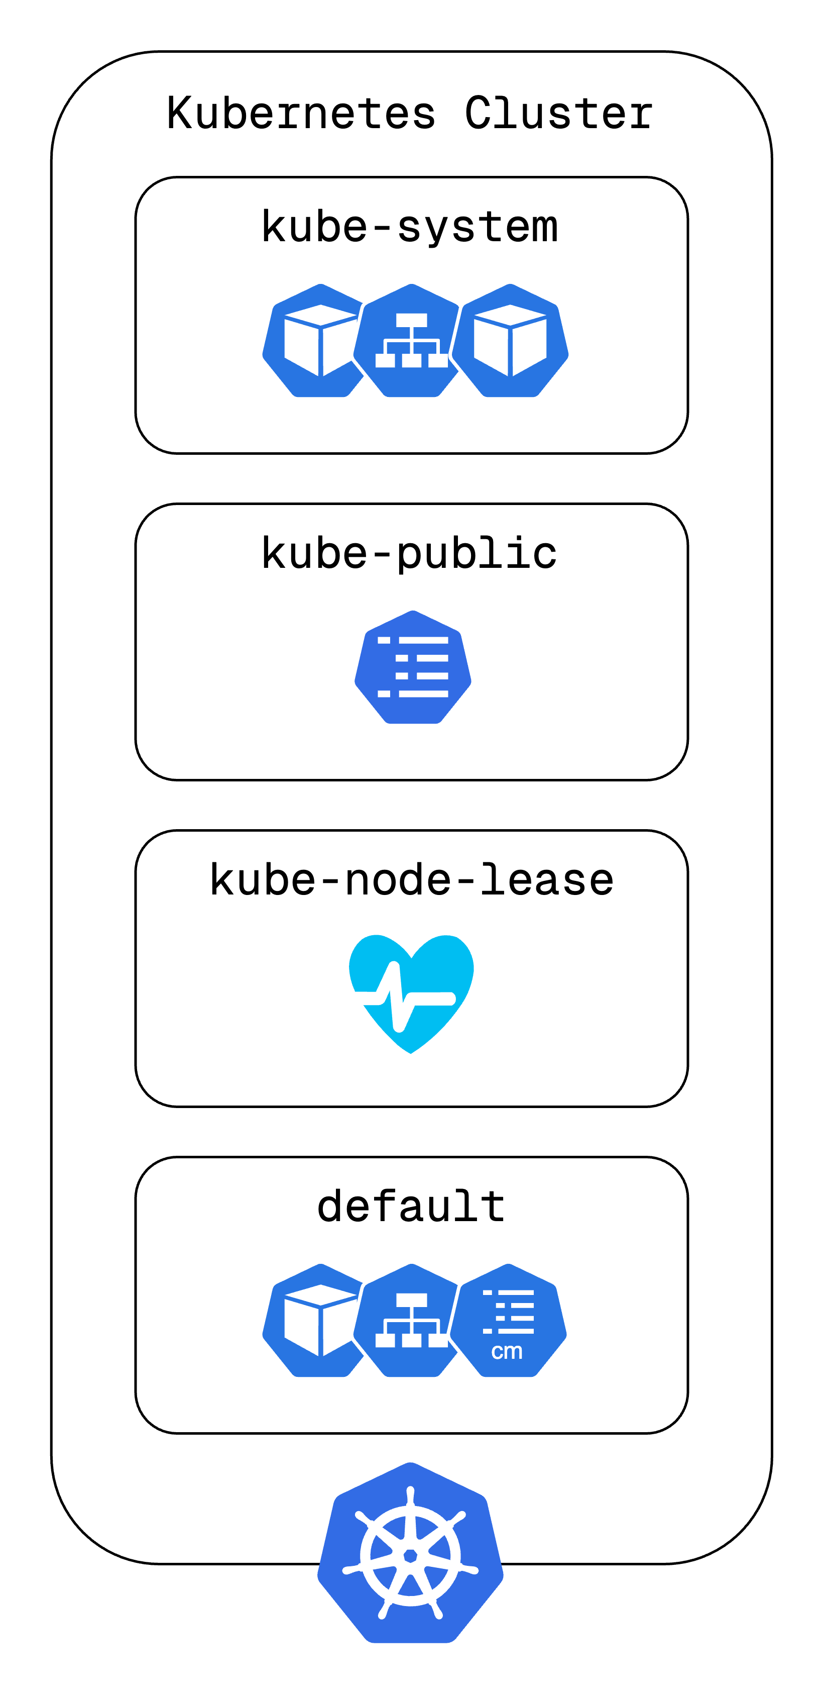
Predefined Namespaces
kube-system: Holds system processes and should not be modified.
kube-public: Contains publicly accessible data, including cluster info.
kube-node-lease: Stores node heartbeat information to track availability.
default: The default namespace where resources are created unless specified.
https://tinyurl.com/k8resources
Notes:
Kubernetes ships with a few predefined namespaces. The kube-system namespace is reserved for system processes, and you shouldn’t create or modify anything here. The kube-public namespace contains publicly available information about the cluster. The kube-node-lease namespace, which is a more recent addition, tracks node heartbeats. Lastly, we have the default namespace—where your workloads go unless you explicitly create a new namespace.

Slide 38
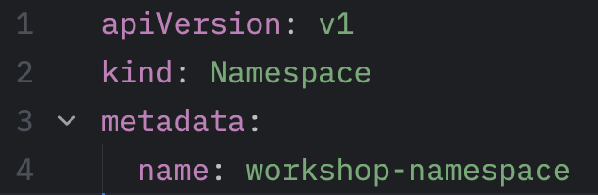
Creating your own Namespaces and Why?
Use CLI to create a namespace
Use a YAML configuration file and apply like you normally do.
Why Use Namespaces?
Better Resource Organization: Separate related resources into groups.
Multi-Tenancy: Allow different teams to work within the same cluster without conflicts.
Access Control: Apply role-based access control (RBAC) per namespace.
Scalability: Helps manage large, complex applications with many components.
Notes:
You can create namespaces in two ways. The simplest way is using the kubectl create namespace command. However, a better approach is using a YAML configuration file. This method provides a record of the namespace creation, making it easier to track changes over time.
Namespaces bring multiple benefits. First, they help organize resources better, so things don’t get cluttered. If you have multiple teams working in the same cluster, namespaces help prevent conflicts. You can also set access controls on a per-namespace basis using RBAC. Finally, as your application grows, using namespaces ensures scalability and maintainability.
Namespaces are ideal when working with multiple teams or managing a complex project with many components. However, for smaller projects with only a handful of users, namespaces might not be necessary. That said, even in small setups, separating critical components like monitoring, databases, and logging into namespaces can be beneficial in the long run.

Slide 39
Next steps

Slide 40
What to do next?
Figure out how to deploy a cluster using your own apps. You can use a Fast API/Flask app in place of mongo-express and PostgreSQL in place of MongoDB and add a React App (inside/outside of cluster) to interact with Fast API server.
Play around with Kubernetes resources using kubectl commands.
Check out this course on YouTube.
Explore cloud offerings like AWS EKS, GCP GKE, Civo.
Kubelabs is also a good place to explore more of Kubernetes.
Notes:
Kubernetes ships with a few predefined namespaces. The kube-system namespace is reserved for system processes, and you shouldn’t create or modify anything here. The kube-public namespace contains publicly available information about the cluster. The kube-node-lease namespace, which is a more recent addition, tracks node heartbeats. Lastly, we have the default namespace—where your workloads go unless you explicitly create a new namespace.

Slide 41
References
Official Kubernetes Documentation https://kubernetes.io/docs/
Inspired from https://www.youtube.com/watch?v=X48VuDVv0do&t=1413s to articulate the flow of workshop
https://medium.com/devops-mojo/kubernetes-architecture-overview-introduction-to-k8s-architecture-and-understanding-k8s-cluster-components-90e11eb34ccd

